Slide 1
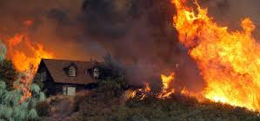
Fire Behavior, Defensible Space, and the TMFPD Wildfire/Fuels Division
August Isernhagen
Division Chief – Wildfire and Fuels

Slide 2
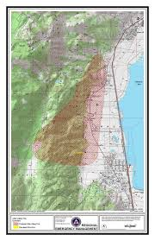
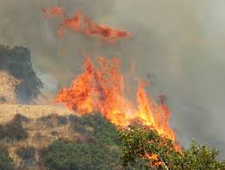
Fire Behavior Factors
General (Fire Triangle)
Heat
Fuel
Oxygen
Wildland Specific (Wildland Triangle)
Fuel
Weather
Topography

Slide 3
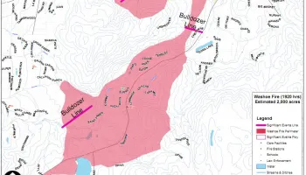
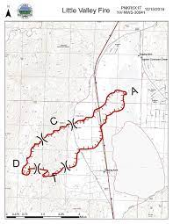
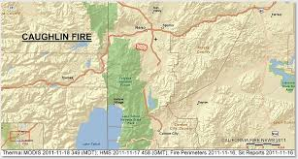
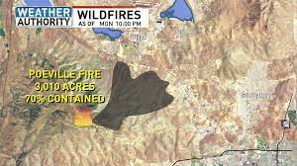
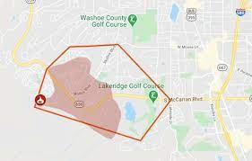
Weather
Wind
Biggest driver of wildland fire
Unusual fire behavior in Western Nevada due to Washoe Zephyr and cold front passage.
Responsible for nearly every catastrophic fire over the last 20+ years (100 + homes lost in five fires)
Relates to defensible space regarding where work is done and how much fuel is removed.

Slide 4
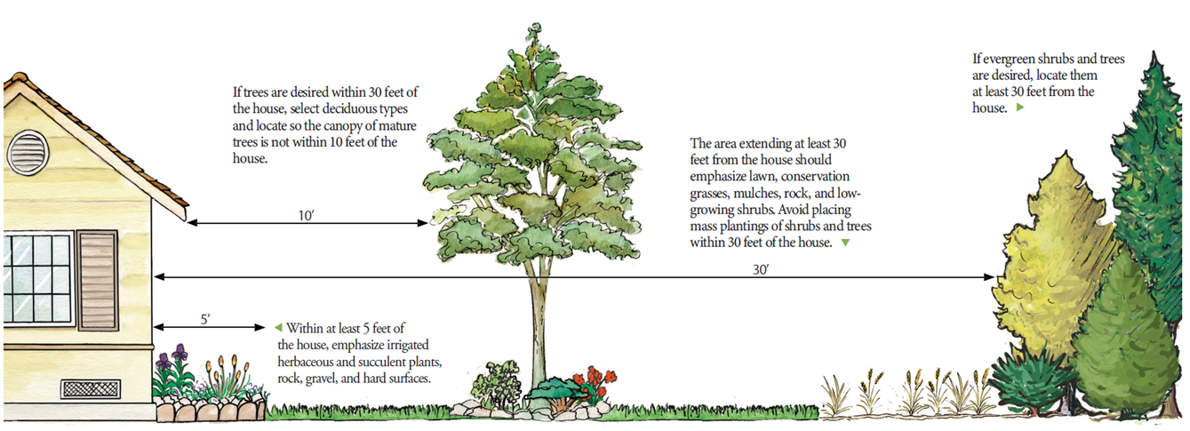
Defensible Space
International Wildland Urban Interface Code
Only "requirements" pertaining to
Defensible Space
Broadly written addresses tree spacing,
fuels and defensible space based on
"hazard rating"
- Moderate = 30 ft.
- High = 50 ft.
- Extreme = 100 ft.
Living With Fire Recommendations
Zone 0 = 0-5 ft. = Nothing flammable
Zone 1 = 5-30 ft. = "Lean, Clean and Green"
Zone 2 = 30-100 ft. = Thinned natural vegetation

Slide 5
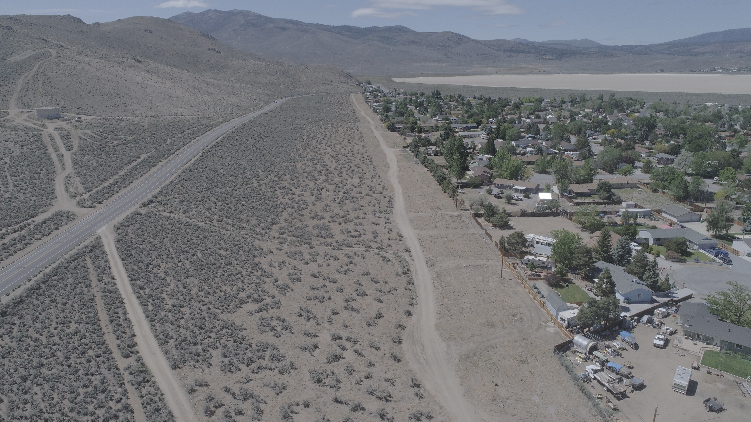
Defensible Space - Continued
Outside 100 ft.
Fuels thinned
Balanced approach considering other concerns
- Invasive Species
- Wildlife
- Erosion Issues
- Aesthetics
- Historic and Cultural Values

Slide 6
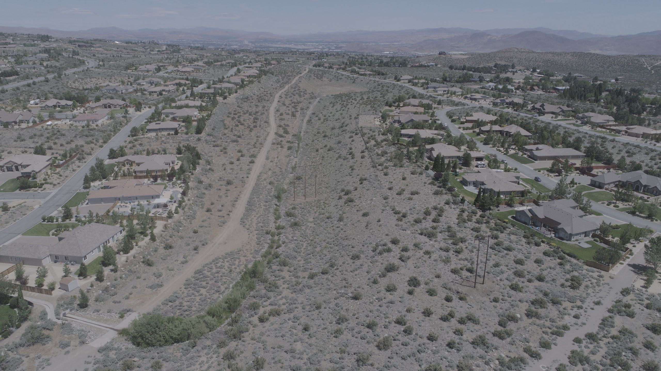
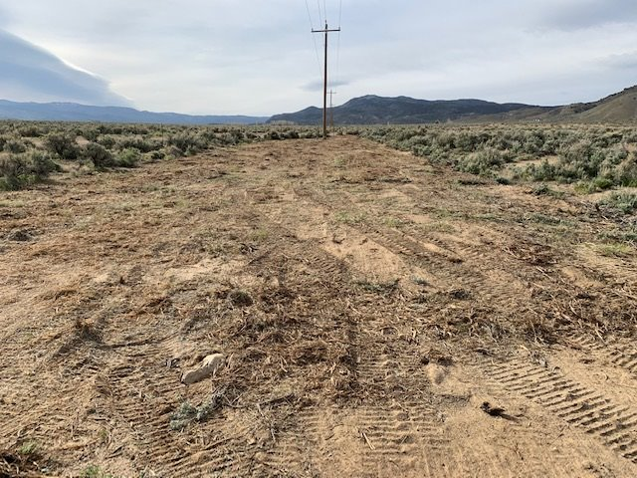
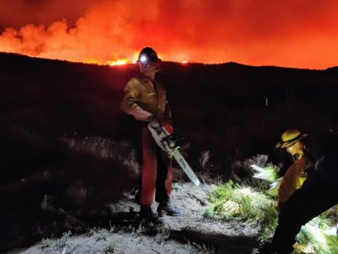
Wildfire/Fuels Division - Personnel
Division Chief Wildfire/Fuels
Four Squads of Five Personnel (20 Total)
Two Heavy Equipment Operators (Bull Dozers, Masticators, Tracked Chipper)
One Crew Boss
One Fire Management Officer
25 Personnel Total
Additional Station and Volunteer Personnel

Slide 7
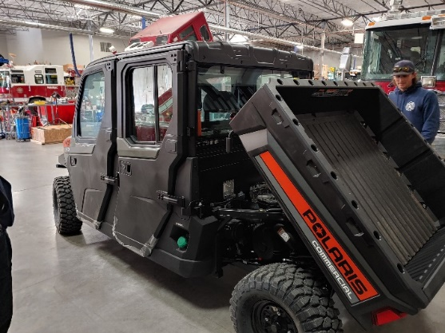
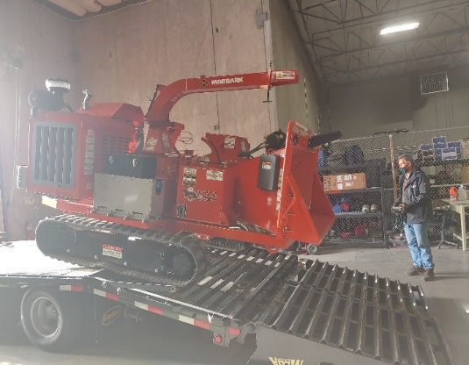
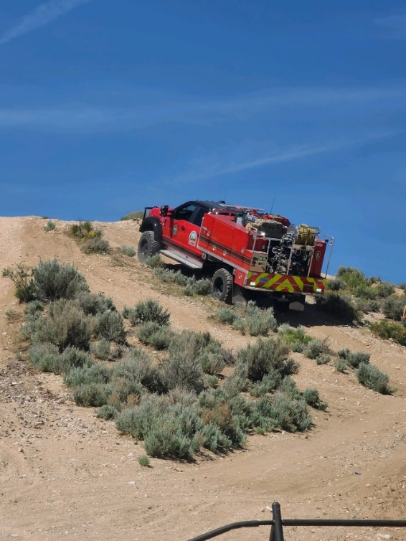
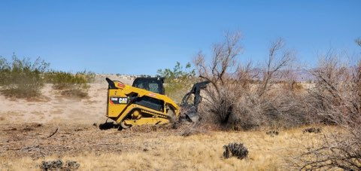
Wildfire/Fuels Division - Equipment
Current Fleet -
4Type V Engines
2 Skid Steers with Mastication Attachments
2 Chip Trucks
2 Wheeled Chippers
1 Tracked Chipper
2 UTVs
1 Water Trailer
Assortment of Herbicide Application Equipment
Assortment of Trailers for Hauling Equipment
Currently Purchasing –
1 F-250 for FMO Position
1 F-350 for Crew Boss Position
2 F-550s for Equipment Operator Positions
Approximately 1.5 Million Dollars in Equipment.
Additional Volunteer and Station Equipment

Slide 8
Questions

