Slide 1
The Unseen Infrastructure
RAILROADS

Slide 5
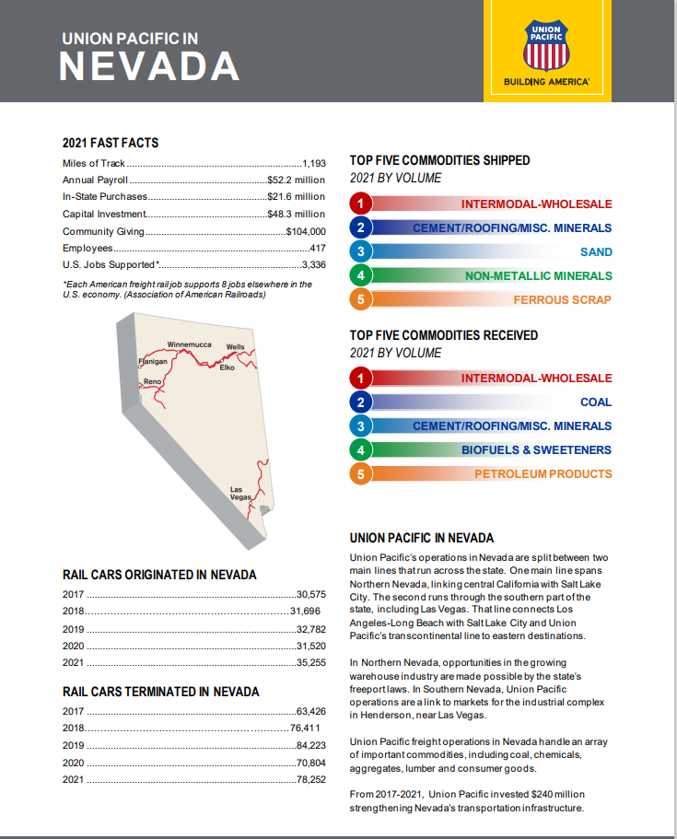
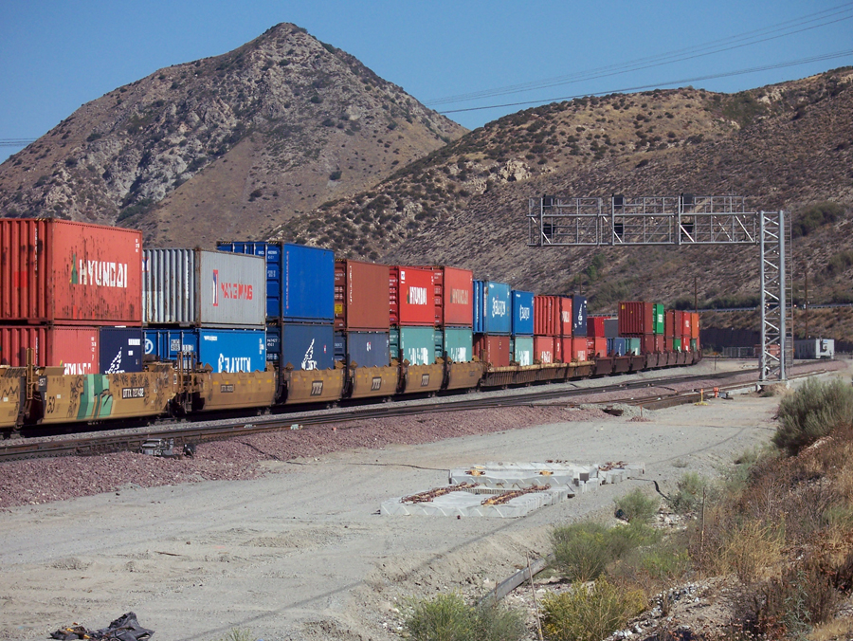

Slide 6
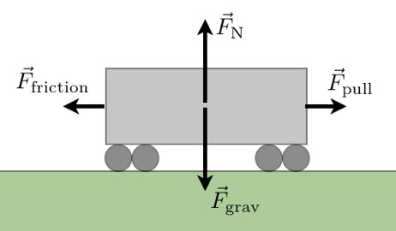
1-500-1 (Trains are ecofriendly and efficient)

Slide 7
Critical to the Economy

Slide 8
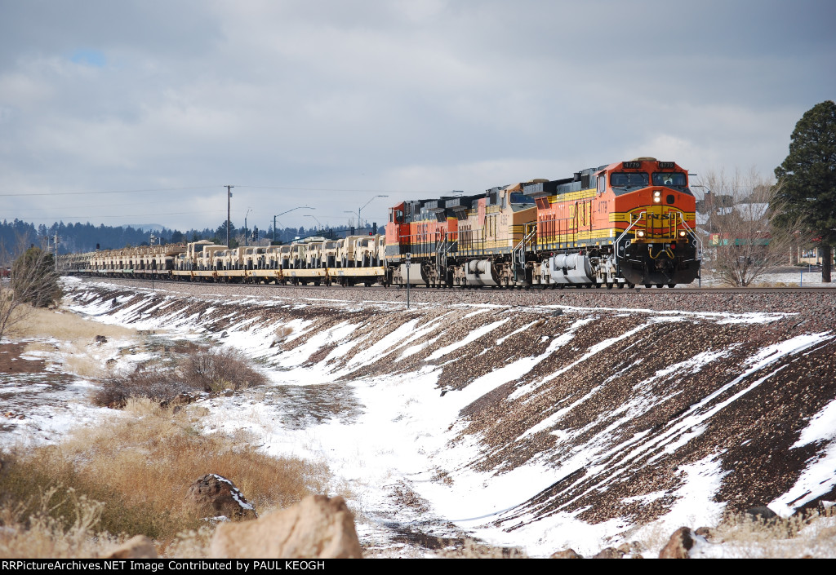
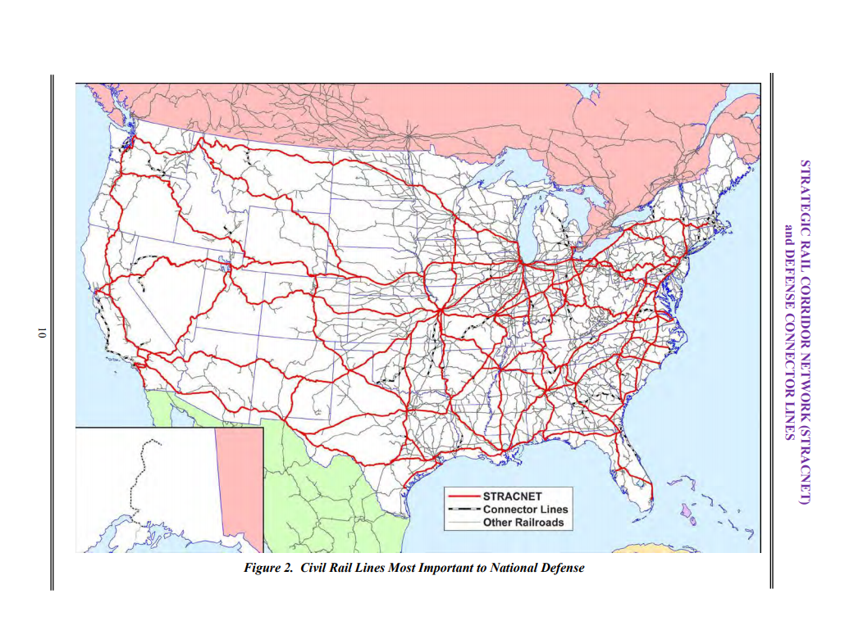
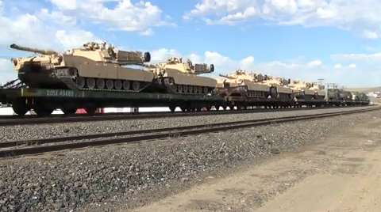
Strategic Rail Corridors

Slide 9
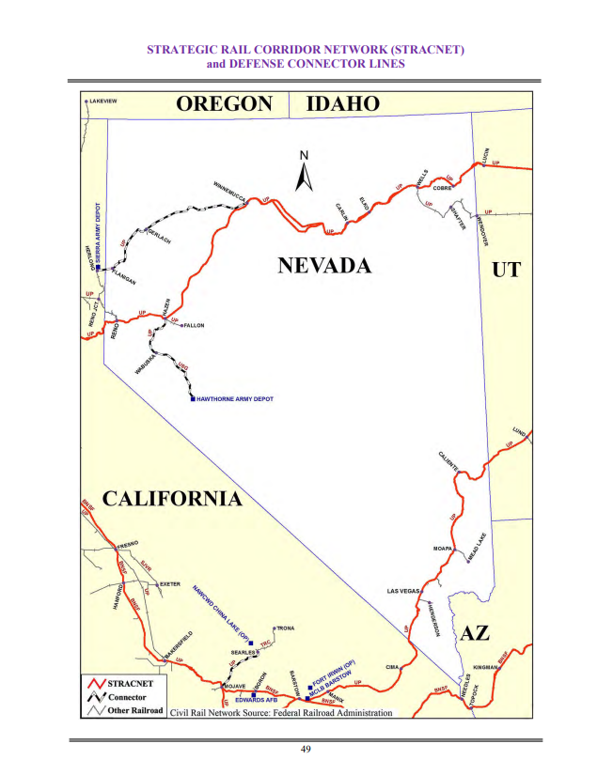
Critical to the Military and Defense

Slide 10
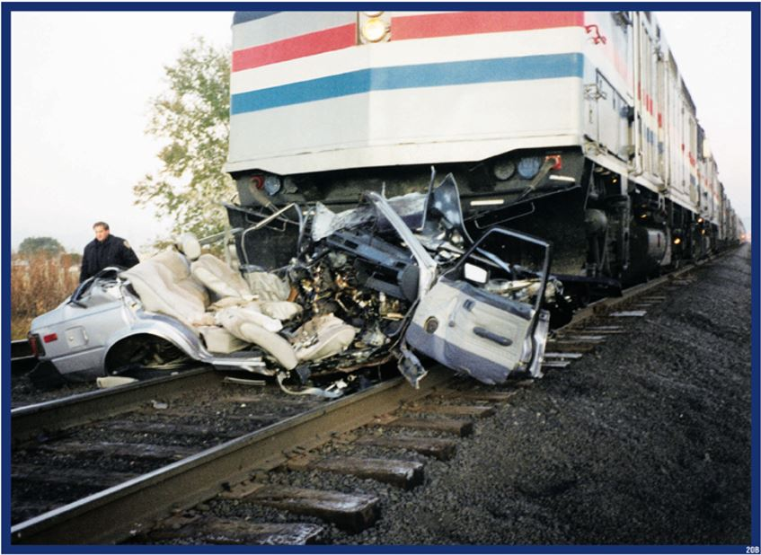
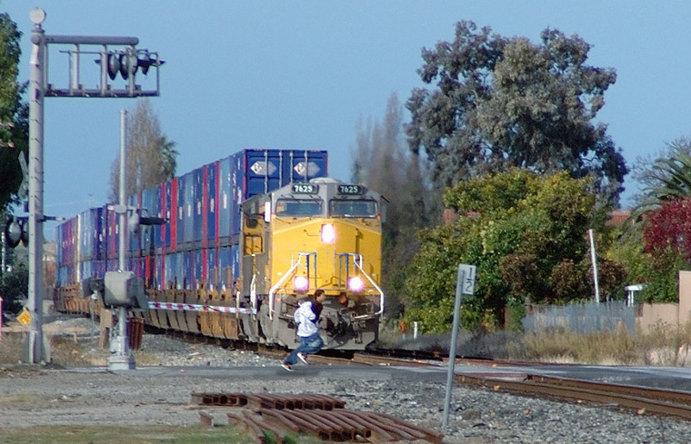
Trains keep our economy moving; but, what can stop a train?

Slide 11
Train Collisions
Every 3 hours
Even in NV/CA
Hwy 95
Painted Rock
Verdi
Lovelock
Truckee
Reno/Sparks

Slide 12
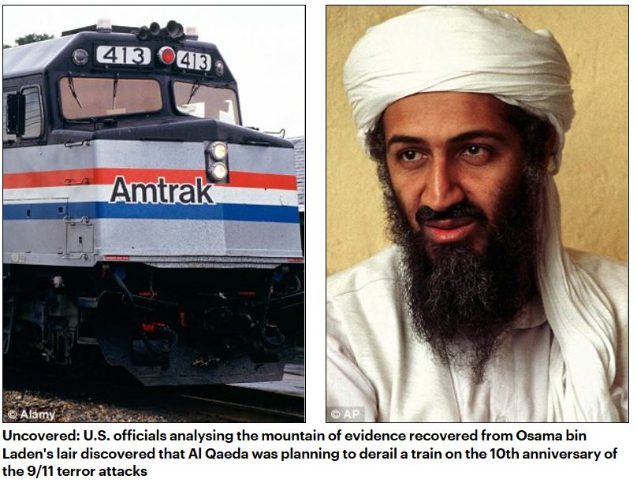
Homegrown Violent Extremist
Al Qaeda plotted 9/11 anniversary rail attack: U.S.
Bellingham, WA rail attack
Neo-Nazi Sentenced in Attempted Amtrak Terror Attack

Slide 13
Any Time is Train Time
How’d I get here
NTSB
My personal story
Trains run 24/7/365
Don’t judge the track

Slide 14
Train Stopping Distance
Understanding that trains can not stop quickly
5280 ft or 18 football fields
What can you see 1 mile away from you?

Slide 15
They’ll stop

Slide 16
Weight Ratio
Trains weigh, on average, 12 million pounds (6000 tons)
A train hitting a car is about the same ratio as a car running over a soda can

Slide 17
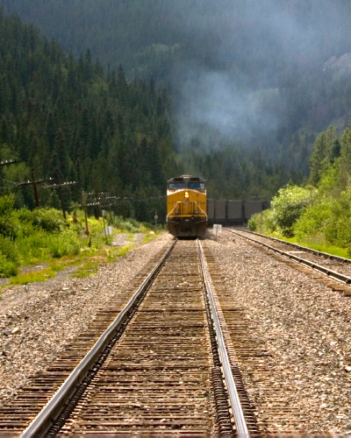
Speed Perception

Slide 18
Multiple Tracks
If multiple tracks, expect multiple trains
Wait for the train to clear
Get a clear view down both sides of the tracks

Slide 19
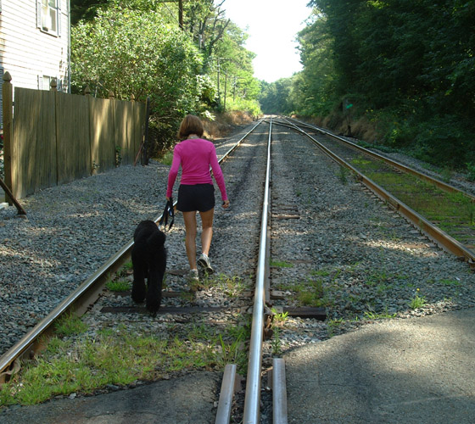
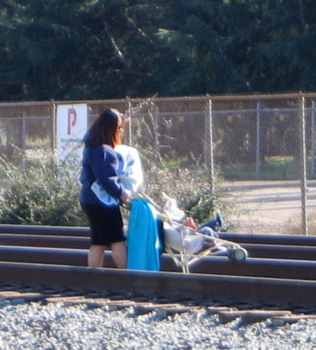
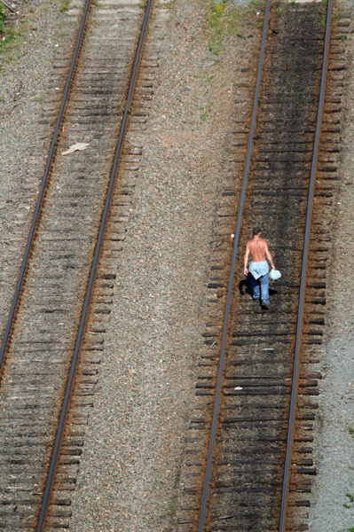
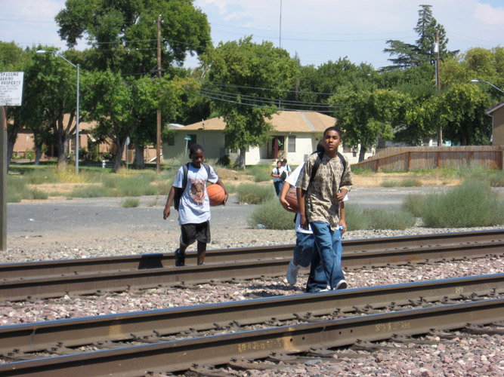
They’re just on the tracks

Slide 20
OK, so what could happen?
PREVENTABLE SUICIDE

Slide 21
Emergency Notification System

Slide 22
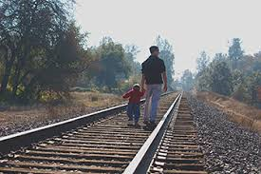
Save a life call the Railroad
CALL UNION PACIFIC RESOURCE MANAGEMENT CENTER AT 1-888-877-7267
OR

Slide 23
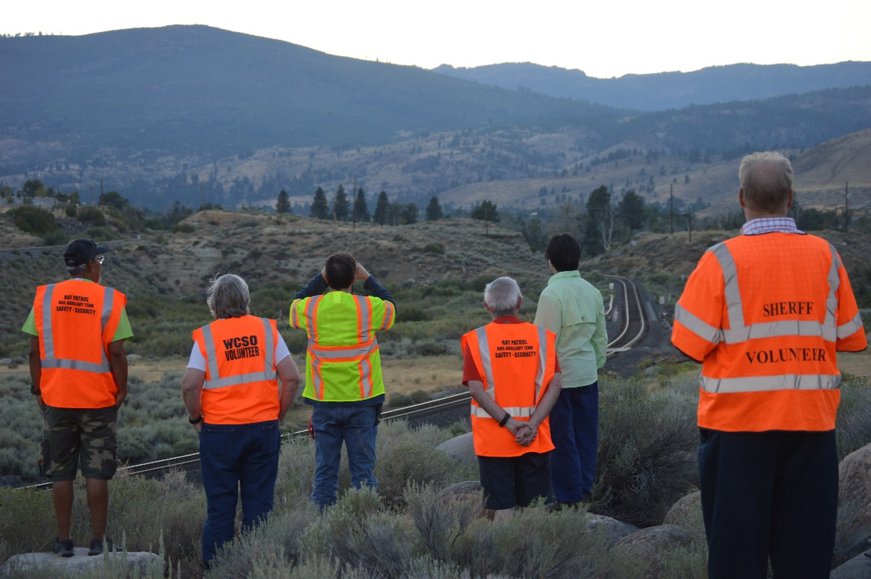
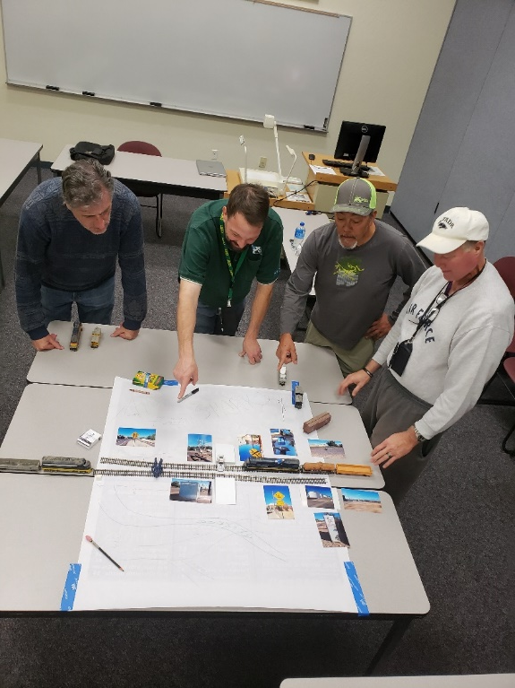
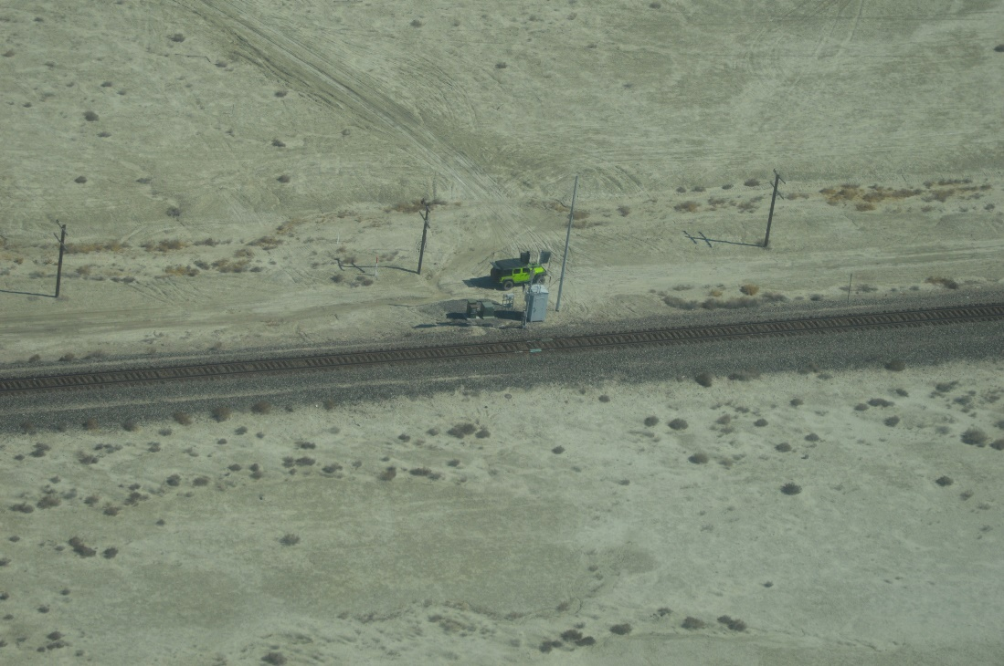
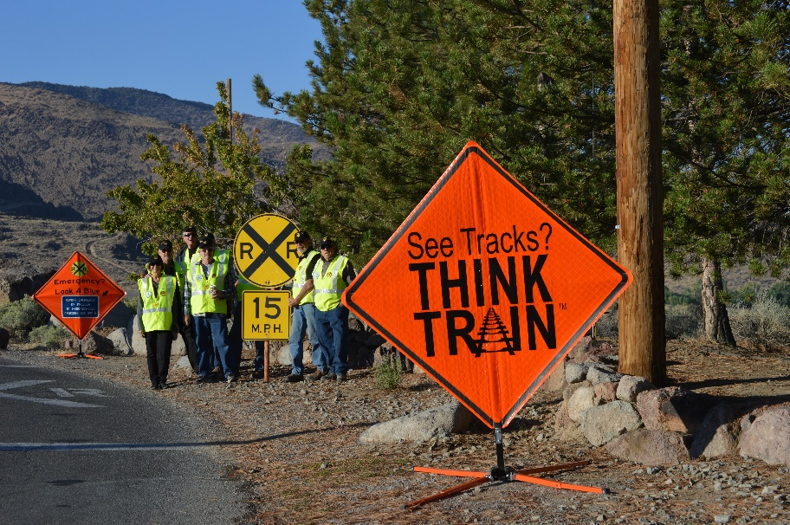
Join WCSO Rail Auxiliary Team
RAT Aviation in Rail Safety/Security

Slide 25
LOOK,
LISTEN &
LIVE!
®
Nevada Rail Auxiliary Teams

Slide 26
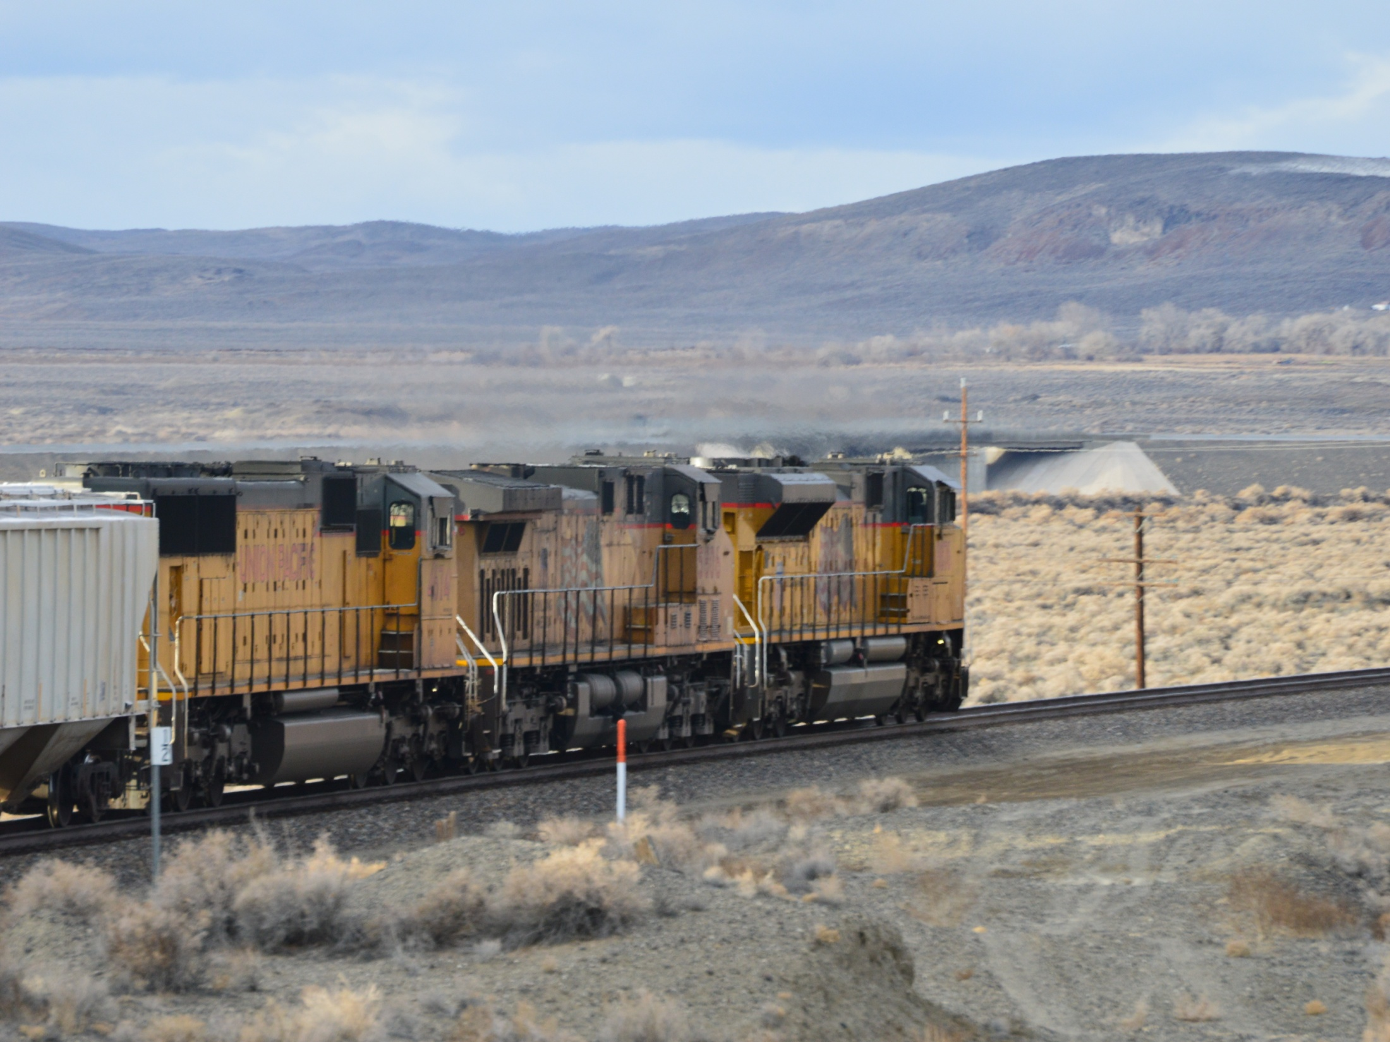
Questions
Rich Gent 775-867-3803
Nevada Rail Auxiliary Teams

