Slide 1



Lemmon drive project
Judy Tortelli, PE
RTC Project Manager
Citizen Advisory Board Meeting
February 15, 2022

Slide 2


Purpose of This Presentation
  Provide construction schedule update
  Provide construction progress update
  Provide upcoming traffic control and detours
  Where can you find information?
  Future freeway improvements

Slide 3
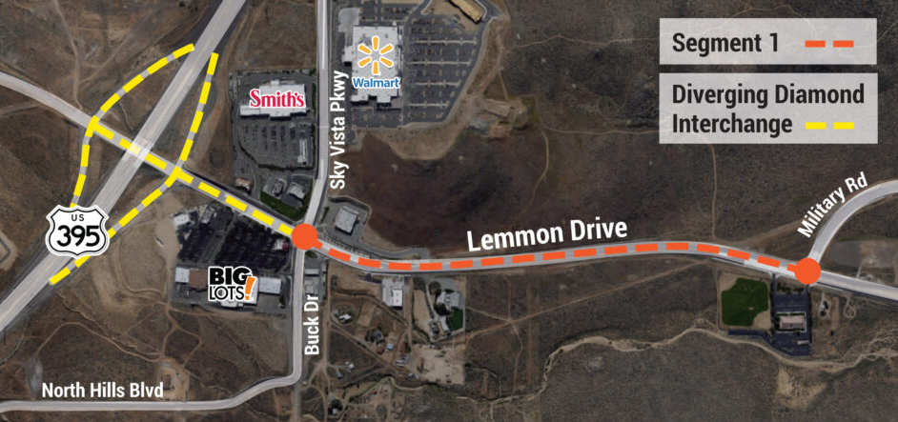
Project Overview

Slide 4
Construction Schedule
  Q&D Construction - Schedule
    July 2021 to November 2022 August
  Roadway Widening
    Asphalt, median island, concrete, drainage improvements
    Paving – complete in March
  Diverging Diamond Interchange
    Traffic signals coordinated, 17,000 cubic yards material excavated
    Retaining walls complete by end of February
    Storm drain, 24” water main relocated, electrical/ITS conduit
X

Slide 5
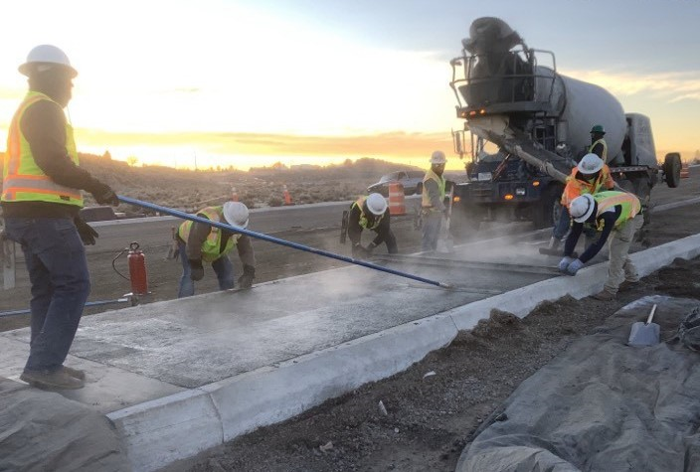
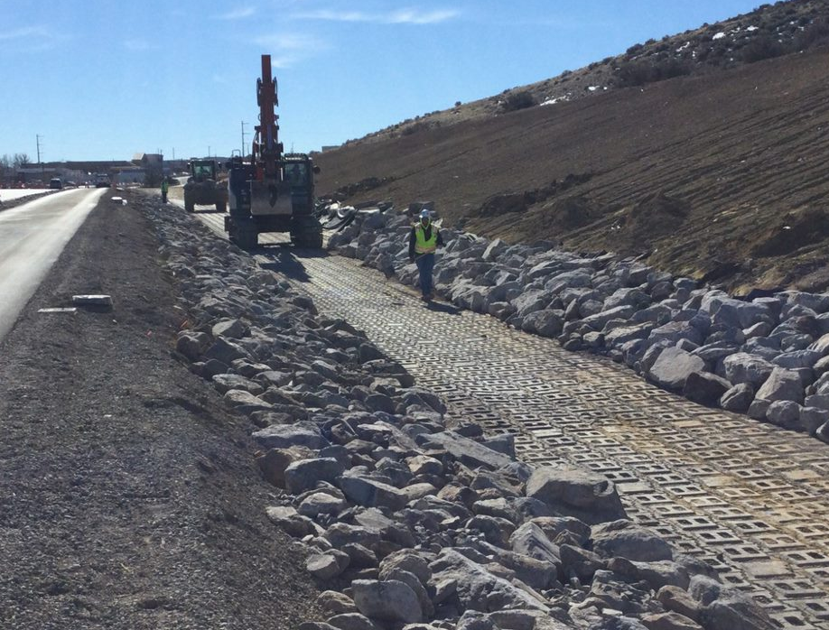
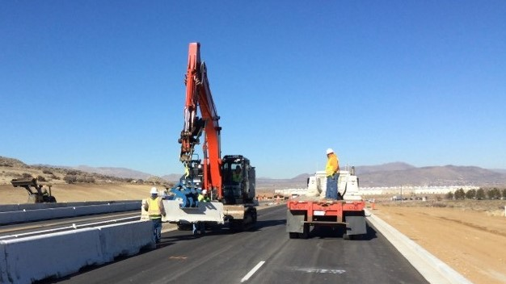
Construction Update – Segment 1
Notes:
Widen Lemmon Drive from 4 to 6 lanes
Continuous raised median for safety

Slide 6
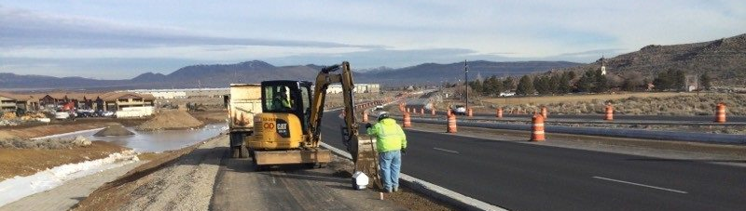
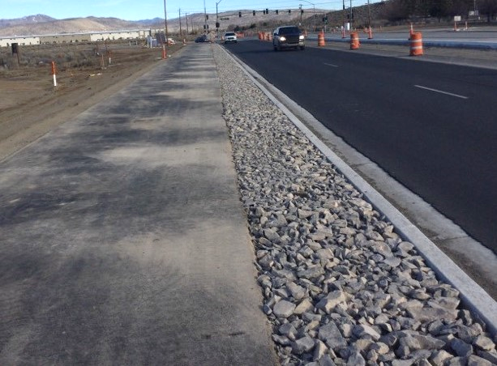
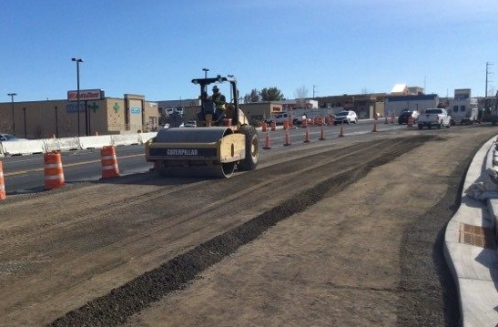
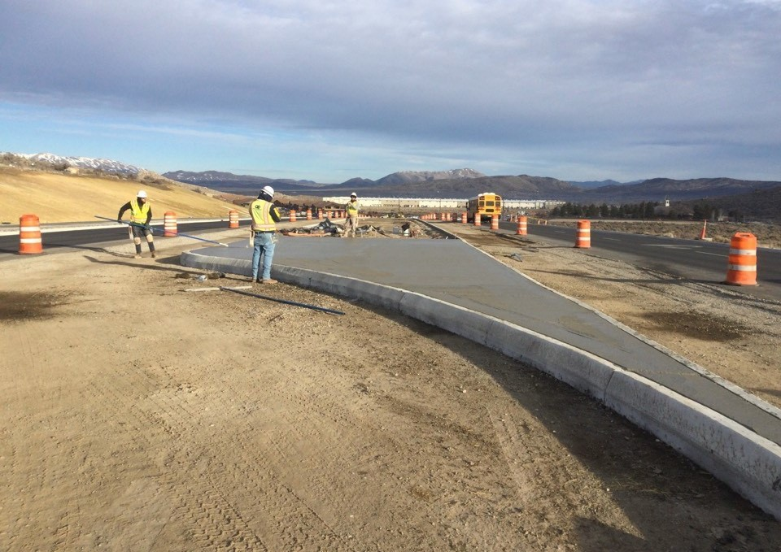
Construction Update – Segment 1
Notes:
Accommodate U-Turns north of Sky Vista Parkway
Multimodal connections

Slide 7
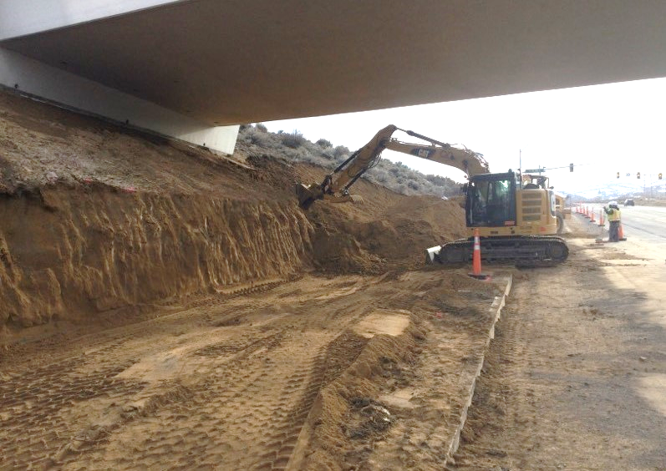
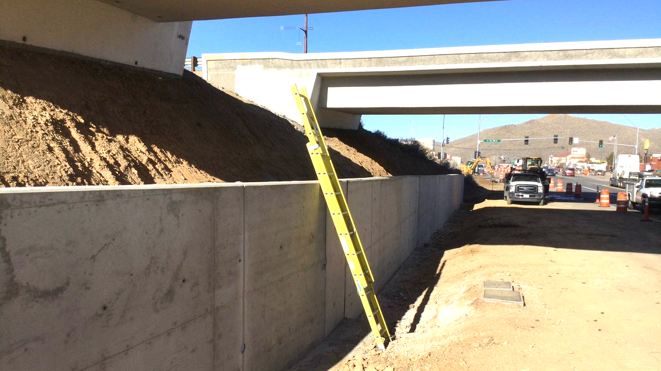
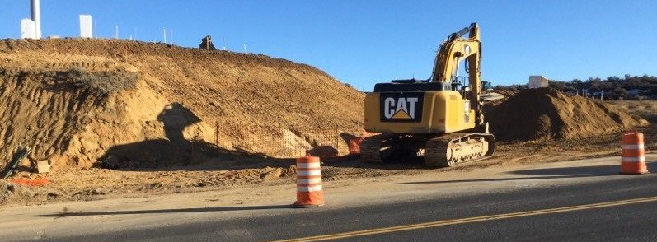
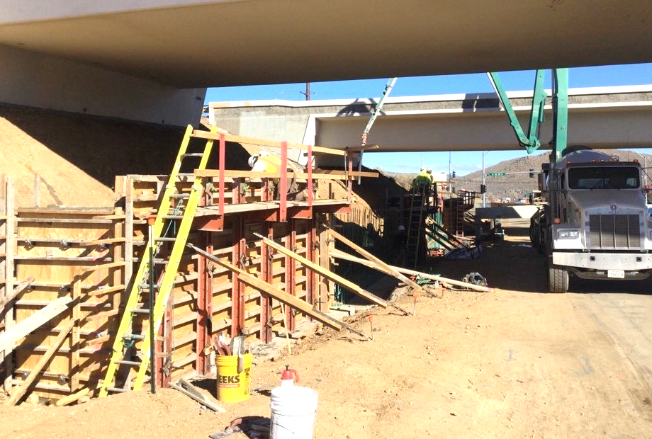
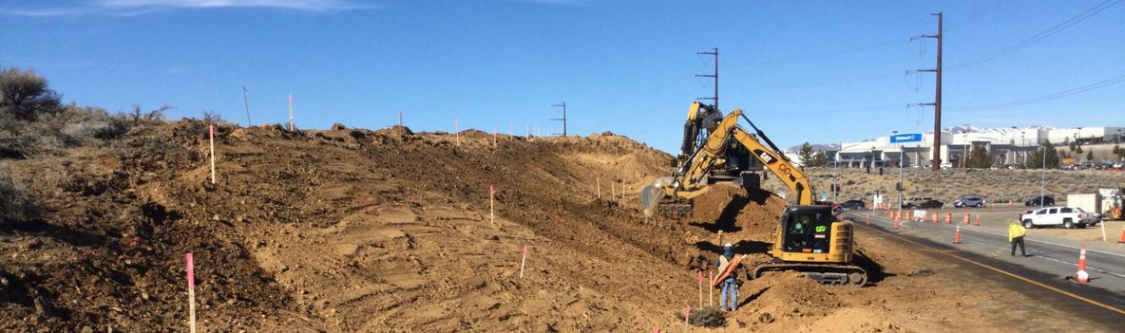
Construction Update – DDI

Slide 8
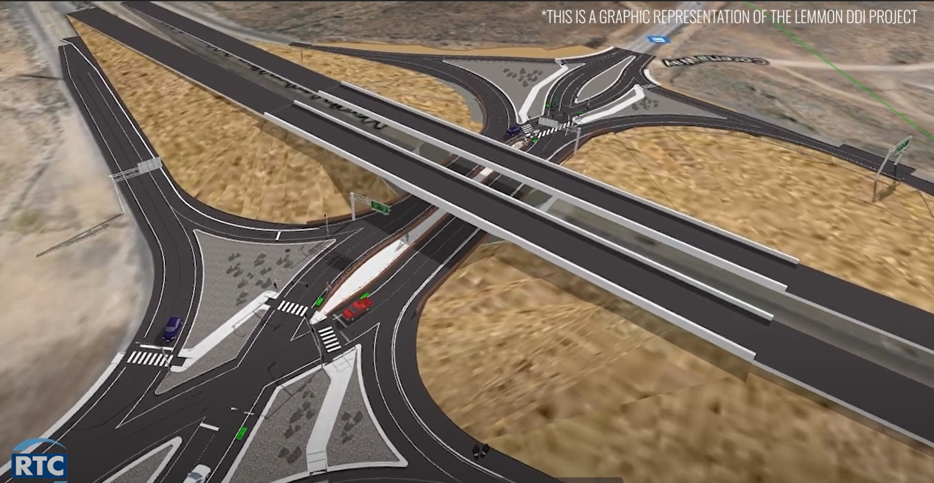
Final Improvements – DDI
Notes:
Reconfigure Interchange to DDI
Free-flow traffic to southbound US 395 on ramp
Improved safety
Dedicated pedestrian/bicycle facilities
Safe, efficient, and cost effective

Slide 9
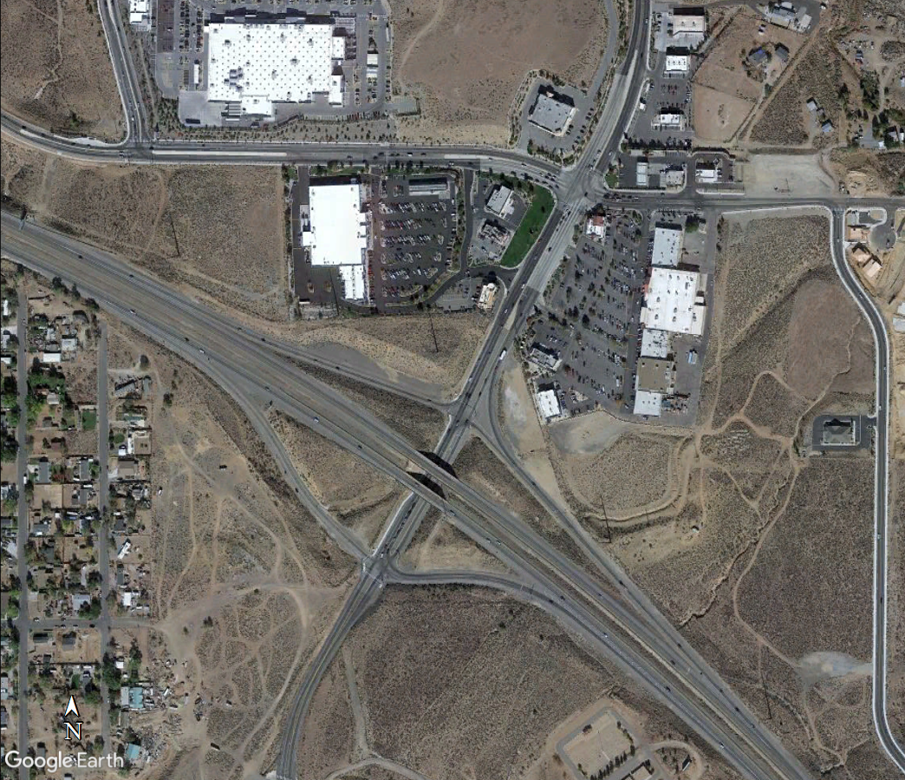
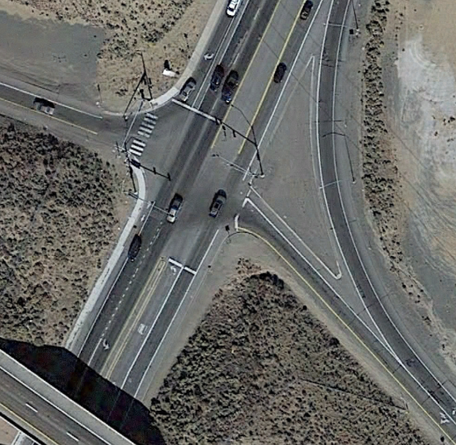
Traffic Impacts
    US 395 Northbound
    Off-Ramp
Notes:
Traffic Control begins end of February 2022 to July 2022
24-hours-a-day, seven days a week
Temporary traffic signals at Golden Valley Interchange
Closures result in two months of time saving and safer conditions for workers and community, not sure if you want to discuss previous options (The project team developed new traffic control plan, resulting in…)

Slide 10
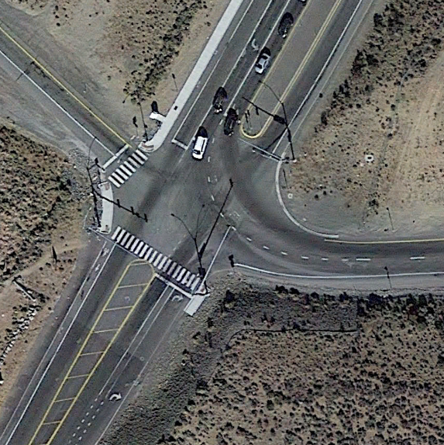
Traffic Impacts
    US 395 Southbound
    On-Ramp
Notes:
Traffic Control begins end of February 2022 to July 2022
24-hours-a-day, seven days a week
Temporary traffic signals at Golden Valley Interchange
Closures result in two months of time saving and safer conditions for workers and community, not sure if you want to discuss previous options (The project team developed new traffic control plan, resulting in…)

Slide 11
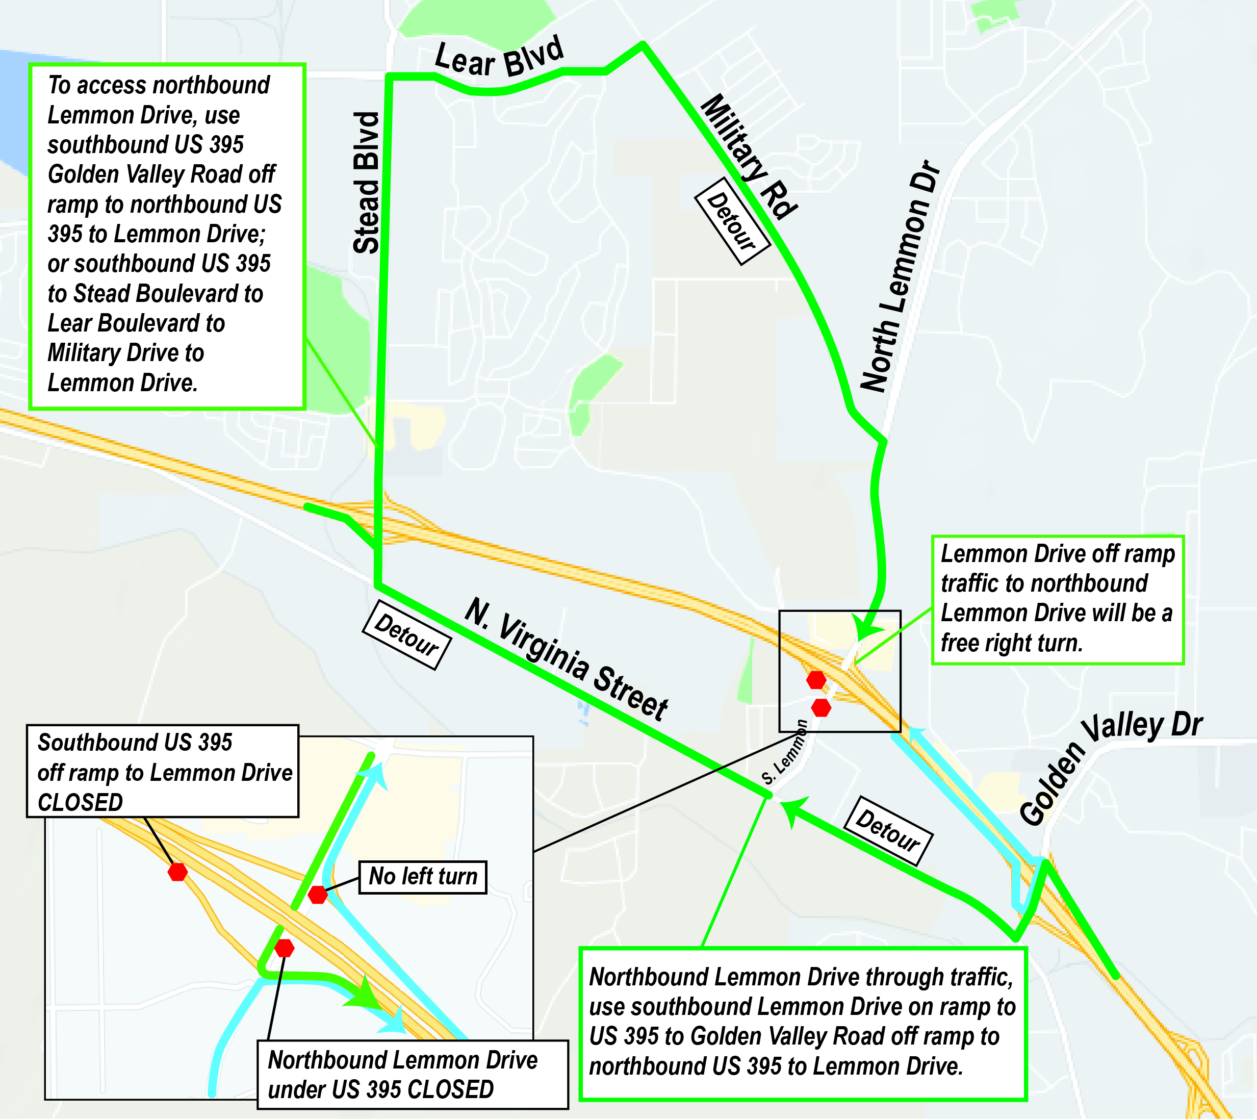
Detour Routes
  Road Closed March to
  mid-June 2022
    US 395 Southbound off-ramp
    US 395 Northbound left-turn
    Northbound Lemmon
  Primary Detour
    US 395
    N. Virginia Street
  Benefits
    Safer for workers and community
    Major movements free-flow
    Time savings and quality
Notes:
Taking low-volume movements from Lemmon and pushing them to Golden Valley/Stead
Discuss temp Traffic signals

Slide 12
DRIVE the new virtual DDI
  Take a “Virtual Drive” on the RTC’s NEW Diverging Diamond Interchange (DDI) at Lemmon Drive and US 395
  Watch the video for a chance to receive a $25 Gift Card!
LemmonDDI.com

Slide 13
Future Improvements
  RTC Segment 2
    Widening Lemmon Drive to four lanes between Fleetwood Drive to Ramsey Way.
    Design in process.
  NDOT US 395 North Valleys Improvements NevadaDOT.com/NorthValleys
    Phase 1A: Parr Bridge replacement: COMPLETE
    Phase 1B: McCarran interchange to Golden Valley interchange: In design, construction anticipated in 2023.
    Phase 2: Golden Valley interchange to Stead interchange: Construction anticipated in 2026.

Slide 14




Contact INFORMATION
RTC Project Manager
  Judy Tortelli, P.E.
  JTortelli@rtcwashoe.com
  (775) 335-1824
Construction Updates
  Stay Informed
  Sign-up on the Website
  Text “Lemmon” to 797979
NorthValleysImprovements.com/lemmon-drive

Slide 15
DDI Benefits
  Improve traffic flow and increase safety
  Fewer conflict points
  Improved sight distance at turns
  Traffic calming
  Shorter pedestrian crossings
  Increased left turn lane capacity without needing more lanes
  “Free" or simple left and right turns from all directions
  Shorter traffic signal cycle length.

Slide 16
Traffic Impacts
  Traffic Control begins end of February 2022 to July 2022
    24-hours-a-day, seven days a week
    Temporary traffic signals at Golden Valley Interchange
    Closures result in two months of time saving and safer conditions for workers and community, not sure if you want to discuss previous options (The project team developed new traffic control plan, resulting in…)

Slide 17
Traffic Control
  Northbound traffic on Lemmon Drive under US 395 will be detoured to southbound US 395 to Golden Valley to northbound US 395
  Southbound US 395 Lemmon Drive off-ramp will also be closed
  Stead Boulevard is a detour route
  Free flowing traffic from northbound US 395 off-ramp to northbound Lemon Drive
  Southbound Lemmon Drive under US 395 open
  *Subject to weather

