Slide 1
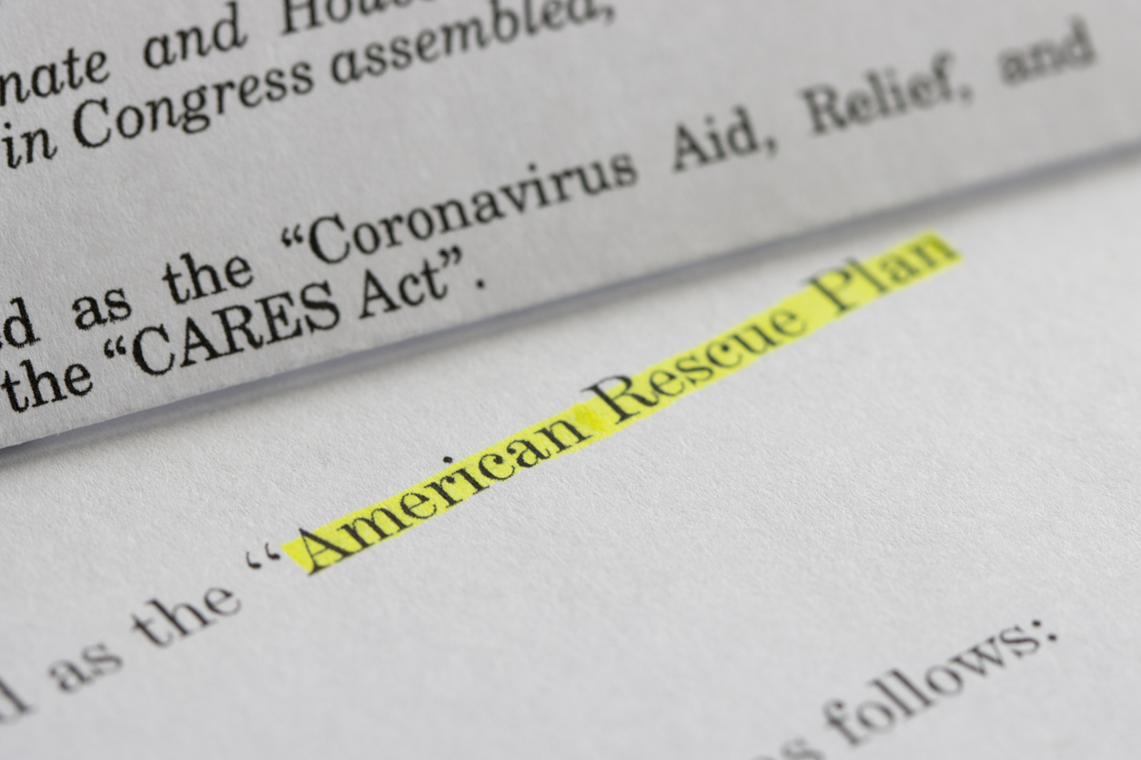
Coronavirus State and Local Fiscal Recovery Fund Update
Washoe County Board of County Commissioners Meeting
December 14, 2021

Slide 2
WASHOE ARPA Projects
Current Board Approved Project Funds $9,112,000
Total with Recommended Urgent ARPA Projects $40,201,764 (44%)

Slide 3
Urgent Projects Recommended
Housing & Homelessness Services
Washoe County Safe Camp Capital - $4,500,000 (BCC approved 7-20-21)
Washoe County Cares Campus Capital - $21,468,706 (includes $4M BCC approved 7-20-21)
Cares Campus – Facilities Operations FY22 - $1,861,112
Homeless Management Information System – Case Management - $250,000
Clerk Staffing for CHAB and Clerk’s Office Administrative - $58,895
Human Services Agency
WellCare Living Supports Pilot Project - $661,500 (includes $612k BCC approved 8-17-21)
Kids Kottage Emergency Beds FY22 - $800,000
Critical CPS Personnel - $527,133
Human Services Agency Vehicles (9) - $283,500
Our Place – Enhancements - $450,000
Our Place – Community Garden Fence - $130,000

Slide 4
Urgent Projects Recommended
Public Defender, District Attorney, and Courts
Public Defender’s Office – Court Case Backlog Personnel & Workstations - $1,316,195
District Attorney’s Office – Court Case Backlog Personnel & Workstations - $2,423,414
Sparks Socially Distanced Courtroom - $380,900
Sparks Justice Court – JAVS Audio Visual Upgrade - $138,638
Reno Justice Court – Courtroom A Remodel - $500,000
Self-Help Center - $90,675
District Court – Courtrooms Audio Visual Upgrade - $1,285,000
Sheriff’s Office
Deputy Sheriff Positions - $1,956,096
Detention Facility UVC Sanitation - $140,000
Medical Examiner
Contract Staff, Pooled Positions, Overtime, PPE & Supplies - $190,000
Health District
Mobile Outreach Vehicle/Command Post - $490,000
Improvements to Public Health Technology Infrastructure - $300,000

Slide 5
Questions? Next presentation to BCC January 25, 2021

