Slide 1
Explaining IV/CB Concerns
Incline Village Crystal Bay
Citizens Advisory Board
Diane Becker, chair
Prepared by Roxanna Dunn
roxanna_dunn@yahoo.com
December 2023

Slide 2
Numerous concerns are repeatedly raised at CAB meetings.
Issue | Counts
Workforce housing, STRs | 130
Distrust of county govt, TRPA, process | 86
Development, growth, overcrowding | 75
Evacuation | 74
Communication, lack of representation | 69
Safety, ebikes | 69
Zoning | 37
Transportation | 35
Traffic, parking | 27
Maintenance (roads, snow removal) | 24
Environment | 21
Tourism | 14
61% of comments expressed frustration with:
County or agency performance
Lack of local representation in planning
Having inputs ignored
Cataloged comments at CAB meetings:
April 2022 to July 2023
13 meetings total
466 comments –
56 different speakers

Slide 3
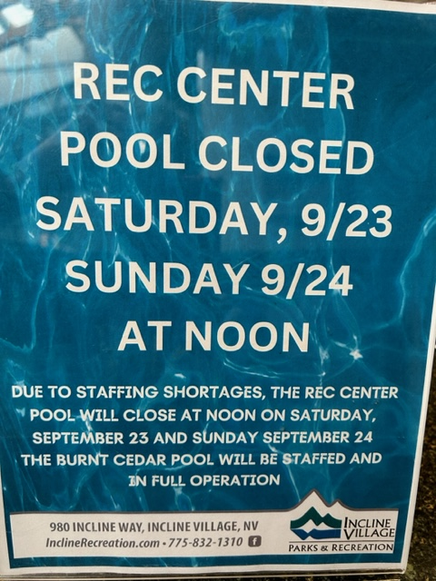
Workforce Housing

Slide 4
Workforce Housing: Everybody suffers from the lack.
Worker burdens
v
Added business costs
Staff turnover
v
Reduced services
v
Inconvenience to residents and visitors
v
Fewer visitors
v
Less tax revenue
Commuting puts an extra burden on our workers…
Difficult to hold a second job if commuting
Extra hours and expense ($6,160 per year)
And businesses suffer…
Difficulty hiring, high turnover, more overtime
Reduced days and hours and services
And then on residents and visitors who cannot get services…
And less tax revenue due to fewer tourists
And more pollution in the lake due to commuter miles.

Slide 5
Workforce Housing: Deed restrictions to encourage affordable housing development need reconsideration.
I understand that at the Nov 8 Advisory Planning meeting, there was a suggestion to allow a larger percentage of the development to be commercial.
TRPA Income Levels - Housing Affordability
Based on a 3-person household.
Type of housing | Income (AMI) | Local job requirements
Affordable | <$71,200 (80%) | none
Moderate | <$106,800 (120%) | none
 | <$106,800 (120%) | none
Achievable | no maximum | One occupant >=30 hours/week for a Tahoe business
 | no maximum | Retired and has lived in Deed restricted unit > 7 years
These categories do not require Tahoe Basin employment.
This category has no income or assets cap, no limit on sales price, so the housing could be high-end condos.
Given these provisions, increasing height, density, and coverage will not likely result in hoped for workforce housing.
Notes:
.

Slide 6
Workforce Housing: At 10%, inclusionary housing makes the problem worse.
31% of the peak population* are workers.
Adding housing at a rate that increases population faster than it accommodates workers makes the situation worse…
  90:10 wf housing shortage increased by 21 units for every 100 built
  69:31 breakeven, shortage remains at current level
… and consumes land that makes future efforts to provide workforce housing more difficult or impossible.
math
* Peak population includes full-time residents, second home owners in town, STR renters, commute workers in town, and day visitors. This is the most all-encompassing estimate of population and therefore the largest denominator, and therefore the most conservative estimate of worker percentage.
P

Slide 7
Workforce Housing: Where to build? Housing on public land is not enough.
The need is 1,205 units by 2026.*
Location | Owner | Density: units per acre (A) | Acres (B) | Number units (A x B)
Southwood (OEM) | TTD | 18.75 | 6.4 | 120
Country club | Washoe County | 15 | 1.3 | 19
Village, Donna | Washoe Schools | 15 | 3.5 | 52 | 191
Village at Harold | USFS | 15 | 13.23 | 198
Oriole Way | USFS | 15 | 0.22 | 3
Northwood | USFS | 15 | 0.58 | 8
Lark Court | USFS | 15 | 0.31 | 4 | 213
 |  |  |  |  | 404
*Washoe Tahoe Housing Needs Report, p.ES-3.
Table data from p.37 of Housing Roadmap, developed by Washoe Tahoe Housing Partnership

Slide 8
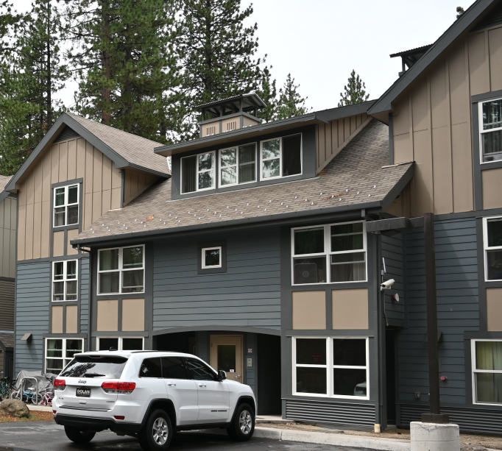
Workforce Housing: Without many public parcels available, private housing options must be pursued.
Funding as outlined in Housing Roadmap
Private development with incentives – >30% workforce housing
Employer provided housing
Redeeming some of the properties lost to STRs
Tighter deed-restrictions with better enforcement
Attractive workforce developments, sensitive to local concerns
Is anybody in the WC Housing Authority (the Grant Specialist) working on housing for IV/CB?

Slide 9
Workforce Housing: Washoe Tahoe is asking Washoe County Commissioners to…
Diane to rework the bullets on this slide.
Have county staff pursue the private housing options listed on the previous slide. Assist large employers in providing housing for their workers. When “Reno/Sparks” Housing Authority (funded by Washoe County), takes on workforce housing, put IV/CB resident on the committee. Avoid inclusionary housing as a “solution.” Don’t allow ”achievable” housing restrictions to result in more luxury condos. Find ways to benefit legacy businesses that serve residents’ needs and preserve local character. Consider residents’ needs before restricting parking – many of our workers need trucks and vans to operate in our rural community.
>>Conclusion

Slide 10
Workforce Housing Appendix: Here’s how 10% inclusionary housing makes the situation worse.
jobs
peak population
6,180
19,900
= 31%
Here’s the math:
Assume adding a complex of 100 units, 10 of which are workforce housing.
100 units X 2.28 pphu = 228 people added to the population.
Divide by current IV/CB peak pop = 228/19,900 = 0.0115% increase (0.0115)
This also means an increase in the need for service workers, and housing, so
6180 jobs* X 0.0115 = 70 additional employees needed
70/2.28 pphu = creates a need for 31 workforce units while adding 10. Net -21 wf units
Numbers in blue font are pulled from the Washoe Tahoe Housing Needs Report; pphu means people per household unit.
Population used here is the IV/CB peak population. 31% is therefore a very conservative estimate.
back
P

Slide 11
Short Term Rentals
Commercial businesses are located in residential areas.
Notes:
Yes, the commissioners have spoken: no caps on STRs in Washoe, but before you sleep comfortably on that decision, there are some things we want you to understand about what this is doing to our community and our homes.
The basic problem is that we have evolved to allow commercial businesses into our residential areas.
We are not anti-STR. When we purchased homes in Tahoe, we knew we would be sharing the area with tourists. We didn’t expect total peace and quiet all year round. But we didn’t expect to be living next to unmanaged hotels either.
You’ve heard the numbers: 94% of Washoe STRs are in Washoe Tahoe; the last number you heard was 642;. now 756 (Sep 23). It seems that you are okay with that number, but we’re hoping this picture of our town blanketed with STRs will have more impact. [Note: The map is old (220208) and only shows 543 STRs, so add 226.]
===========================
Map is from https://ivcbcommunity1st.org/washoe-county/short-term-rentals-strs/str-permit-application-maps-and-info/
Residences used as STRs comprise 9.5% of all residences. [calculated STR_permits divided by IVCB_residential_units).

Slide 12
STRs: County pushes forward in spite of community concerns.
History of STR ordinance drafting, communication, implementation.
October 19, 2021 meeting
  Occupancy formula questioned
  No access to STR information (location, violations)
  Clarification of enforcement procedures needed
Promise to review in 6 months became
  county planners proposing changes
  presented to community meeting attendees, November 15 and 16, 2023
  with discussion limited to the proposed changes

Slide 13
STRs: Online booking has changed the nature of short term rentals.
 | BEFORE ONLINE BOOKING | NOW
Decision to rent | Personal decision made by owner | Booking sites solicit owners to sign-up; investors, to sell
Advertising | Local newspapers or ski magazines, had to be renewed | International reach, 24/7, continuous, professional ads
Vetting renters | Phone call, references, credit check | Booking site verifies identify, xrefs against fraudulent accounts
Payment and taxes | Paid by check mailed to the owner or agent | Paid by credit card through the booking site; handles TOT
Damage, insurance | Deposit, optional extra policy | Booking site offers damage and liability insurance
Cleaning | Owner or agent schedules cleaning service | Booking site can schedule and manage cleaning service
 | More personal and hands-on Individual owners | Automated, handled for you Big business
Notes:
One point we want to make is that STRs are businesses, not just Ma and Pa Kettle renting out a room to put Tom through college. The big change came when online booking sites changed the nature of renting out a vacation home.
The left column lists the kinds of tasks one has to handle when managing a short-term rental. And then you can read across to compare.
I’ll just speak to two of the tasks: Advertising – before online booking, you had to place an ad in target newspapers or ski magazines and you had to keep renewing them through the season. With online booking, you sign up with Airbnb or Vrbo or whatever, and you immediately have international reach, available 24/7, continuous – you don’t have to renew; and they provide professional copywriters to write-up descriptions along with professional photographers to make your place look great.
Payment and taxes – before online booking, the renter sent you a check in the mail, you had to deposit it, track down and deal with the renter if the check bounced, and you had to keep all the records associated with taxes. Online booking sites process credit card payments and even handle payment of TOT taxes.
Before – personal and hands on, mostly handled by individual owners.
Now – many tasks are automated, handled for you – so easier to manage multiple STRs, and driven by the big online businesses.
=========================
Transient Occupancy Tax (TOT) is paid to Reno-Sparks Convention and Visitors Authority. IVCB’s contribution nets RSCVA around $45M a year of which Washoe County gets almost $6M. These are numbers from RSCVA reports for vacation rentals. I am still trying to verify that STRs are reported as Vacation Rentals

Slide 14
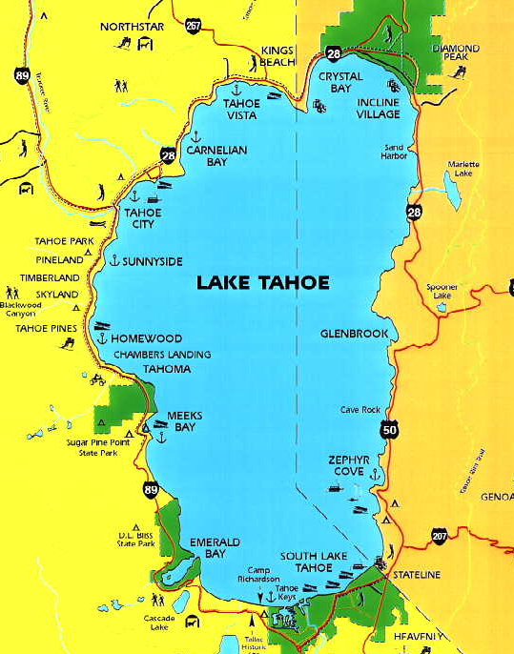
STRs: Not just mom and pop owners, investors coming in.
Currently,
11% of STRs are owned by business entities.
10% of owners own more than one STR in Washoe Tahoe.
We expect more investors will be buying up properties, as:
Housing prices continue to rise.
Online vacation rental business expands.
Long-time residents get fed up and leave (creates a vicious cycle).
Washoe Tahoe remains the only area in Tahoe without an STR cap.
Notes:
Currently, 11% of STRs are owned by business entities, and 10% of the owners own more than one STR in Washoe Tahoe. We expect these percentages to increase due to the following factors:
The boom in housing prices over the last several years. (Buy in a low market. Rent out as an STR to cover costs until market goes up, and sell at a profit.)
Expansion of online vacation rentals. Marriott and Hilton getting into STR bookings. More services interconnected – like booking your flight, rental car, and STR at one site.
Long-term residents getting fed up and leaving – no data, but anecdotal evidence that residents no longer find Incline Village the quiet, peaceful, and congenial community it once was. They are tired of fighting crowds to use the beaches and trails. And, if a neighborhood reaches a tipping point, no one but STR investors will want to buy there.
With all other towns around the lake imposing STR caps and most of them with waiting lists, Washoe Tahoe becomes the wild west of STR conversions.
Commissioners have said they don’t want the county in the middle of neighbor vs. neighbor squabbles. This is not the Joneses vs. the Smiths; this is the Joneses vs. Vacation Rentals, LLC. Class action suit? You will be taking on the whole online booking establishment.

Slide 15
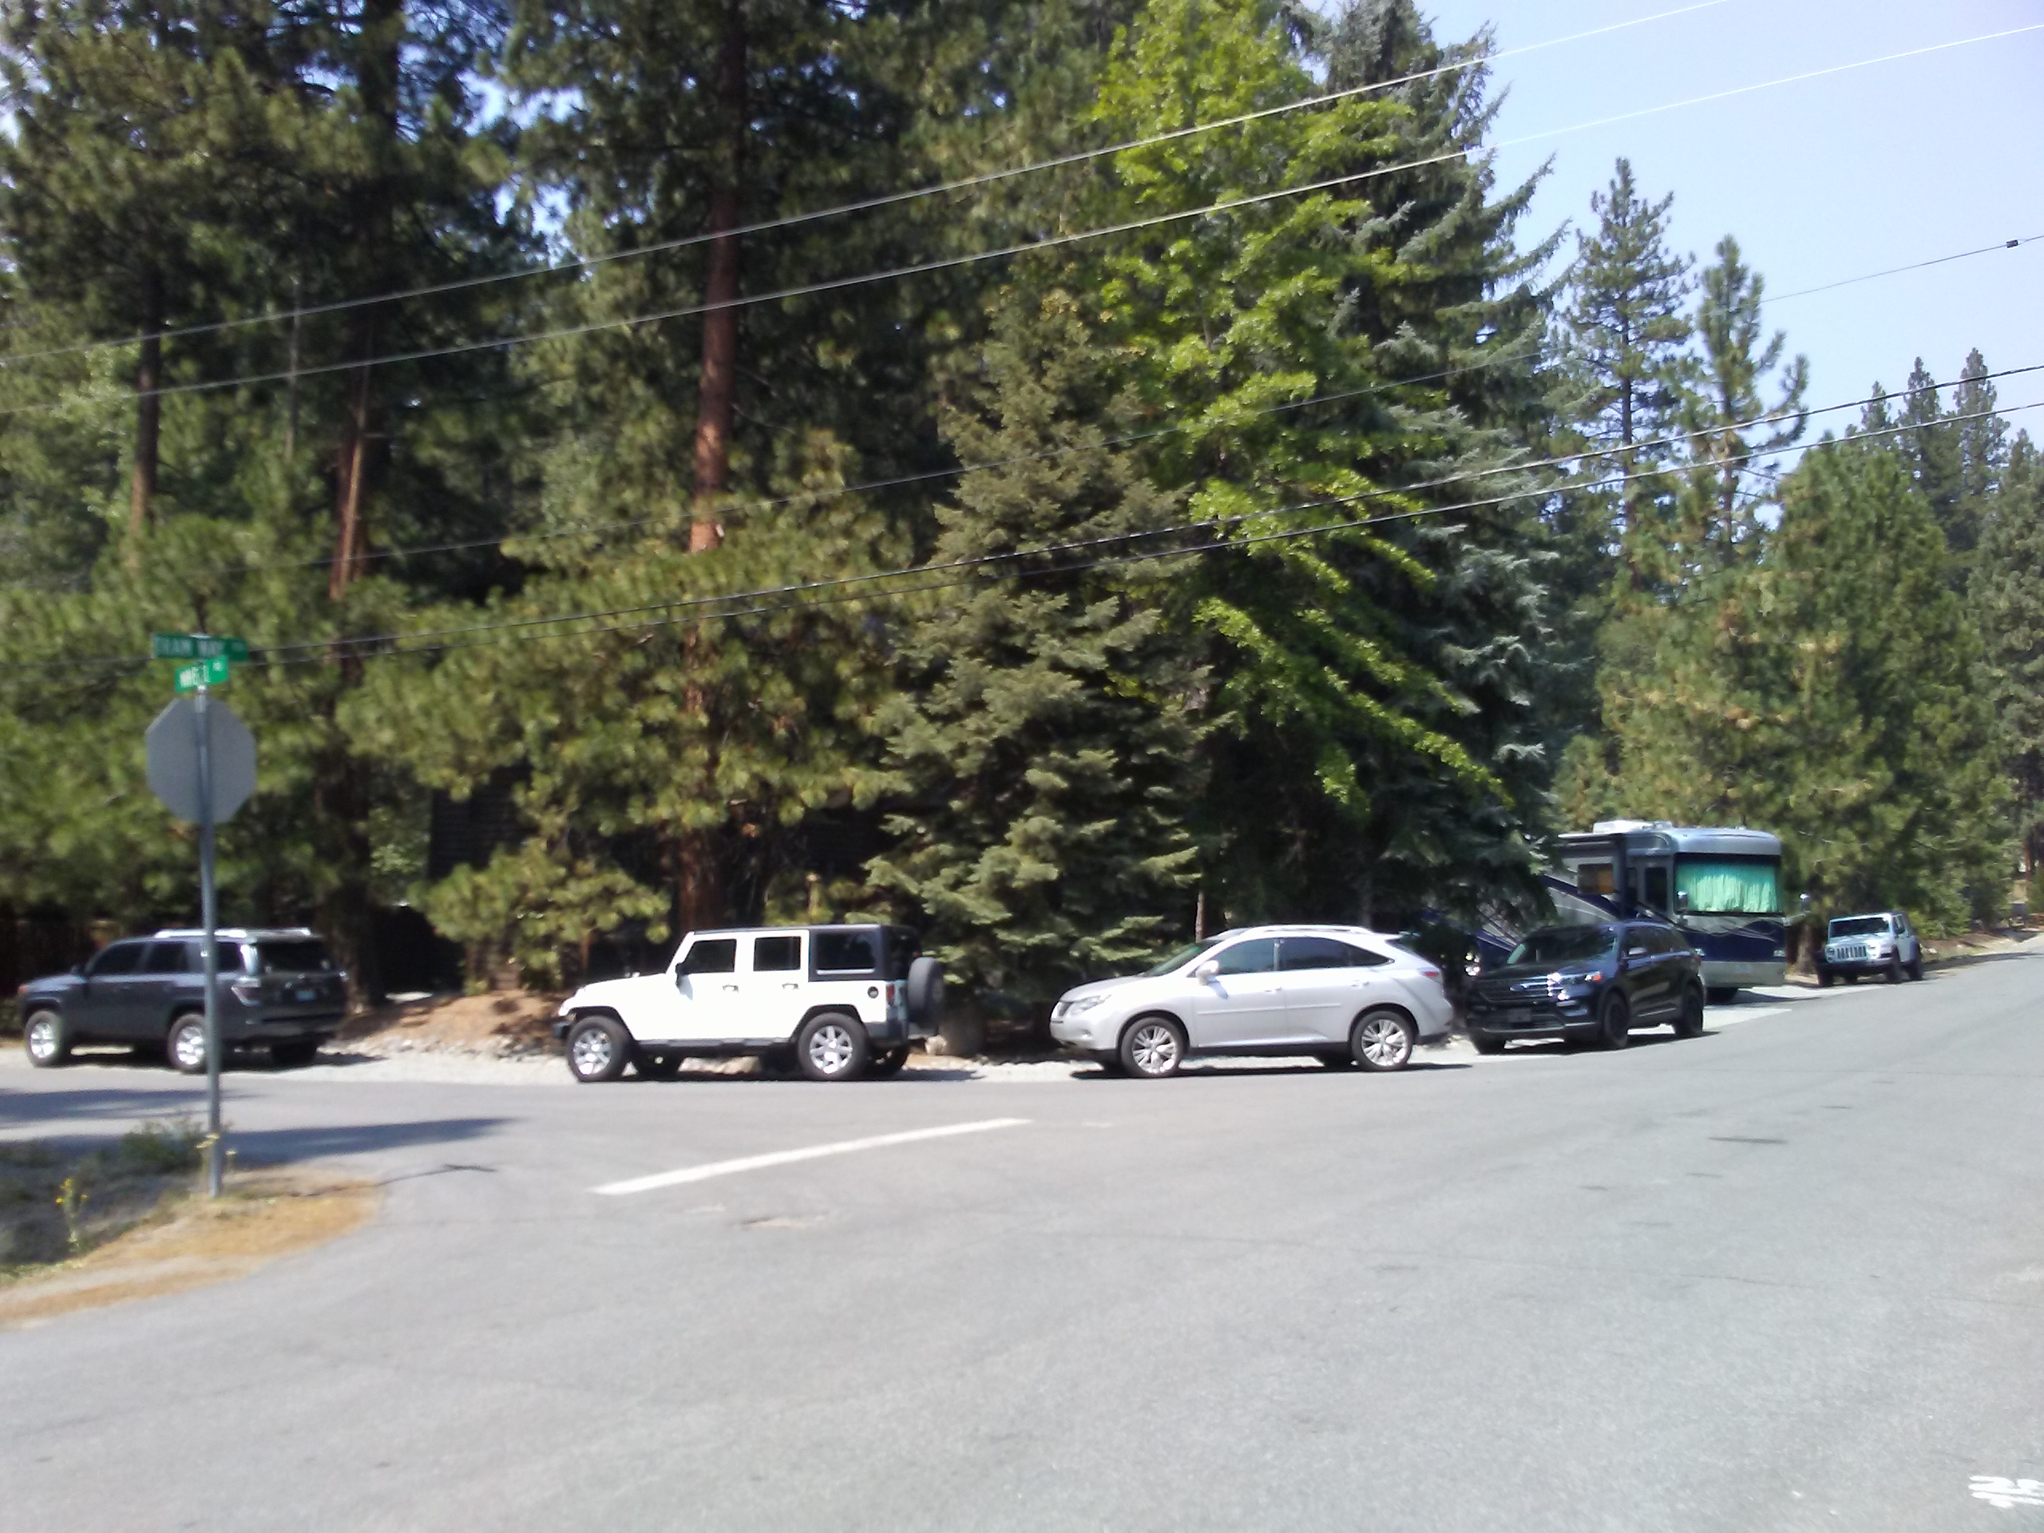
STRs: What about the property rights of neighbors?
STR
Nuisance factor
  Unrelenting noise, disorderly conduct, trash, parking – unsupervised hotel
  Lack of enforcement – burden on neighbor to document and file complaint
  Neighbors receive no compensation.
Danger in an evacuation
  Less careful about fire danger
  Communication challenge, lost without GPS
  No incentive to shelter in place
Hollowing out the community
  Loss of neighborhood, loss of HOA control
  Loss of workforce housing
  Loss of young families and school-age children
  Loss of residents who are fed-up
  Increases rents up to 20%; housing prices, up to 14%
My home has become “a nice place to visit, but I wouldn’t want to live there.”
HOA was an issue that the commissioners agreed to address, though I did not completely understand the history here. – seems centered in Tyrolia Village
Notes:
In the Board meeting on STR caps, several of you showed great concern for the property rights of owners. I’d like to make a case for the property rights of neighbors
You’ve already heard us complaining about the nuisances. Please recognize that in some areas, these nuisances are unrelenting. In my experience, over the summer… one groups leaves on Sunday afternoon, and the next group arrives Monday morning – almost no breaks in the action. So, the nuisances are unrelenting.
STR renters are not normal neighbors; they are on vacation, so noisier, out on the deck more, in party mode much of the time. If I want to have a family barbecue on my deck, I can do it, but with STR renters out on the deck next door, it’s more like being at a public park than enjoying the peace and quiet of my backyard. County staff stated that a reduction in complaints to the hotline shows things are calming down; it may also indicate that people have given up because enforcement was late, ineffective. And keep in mind that neighbors receive no compensation for the troubles they endure.
Danger in an evacuation – STR renters are less likely to be aware of fire restrictions and have been known to use charcoal barbecues, set up campfires for wiener roasts, flick cigarettes off balconies. Currently, there is no way to contact them in an emergency. Whereas hotel visitors would have guidance from hotel staff, STR renters are loose cannons sprinkled through our neighborhoods
Hollowing out communities may be the saddest consequence.
Remember our map? Our neighborhoods have been riddled with STRs.
Some HOA's struck early and banned STRs, but one of the largest in the area [Tyrolia Village] is in danger of losing control of the board to STR owners.
We’ve talked about workforce housing. Losing workforce families is a significant contributor to loss of school population which is likely to force WCSD to close our middle school. The close-knit community that drew many residents to Incline Village is being eviscerated. You would not want this to happen to your neighborhood.
A study by Harvard Business Review and Pew Charitable Trust (not specific to Tahoe, but applicable) gave these stats on the effect of STRs on local rents and housing prices. Not only do the STR conversions reduce available workforce units, but the associated increases in rent can force workers to leave.

Slide 16
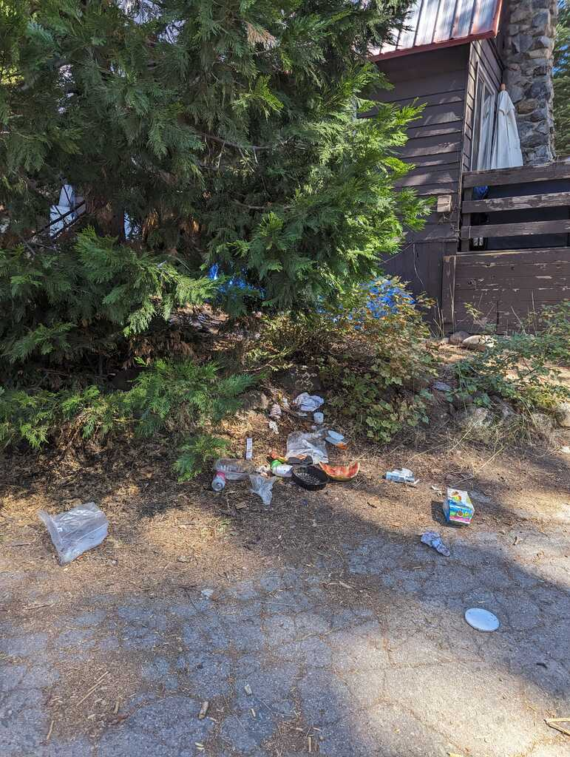
STRs: We are not anti-STR. We simply want the same protections from rampant take-over that have been afforded most resort communities.
Reduce STR impact: Cap the number of STRs. Limit density in residential neighborhoods. Reduce the allowed number of rental days. Ensure ADUs are not used as STRs. Reduce STR speculation: Require a one-year mandatory waiting period between purchase and applying for STR permit. Do not automatically rollover STR permits to new owners. Increase property tax on STRs since they are businesses. Increase enforcement of rules. Clarify and educate on complaints versus violations, processes and consequences
morning after
Highlighted items are under consideration with STR Ordinance revision.
Notes:
[Read title.]
There are a number of things you can do to help preserve our community. We are not asking for everything on this list. These are the numerous options that could alleviate the problems.
Reduce STR impact :
Cap – has been recommended over and over.
Limit the allowed rental days to maybe 3 weeks a month – give neighbors a break and a chance to enjoy their homes.
ADU’s put houses closer together, are very tempting for people trying to get more money out of their property. Will be highly prone to parking issues.
Reduce STR speculation:
Truckee has instituted a mandatory waiting period – decreases the likelihood of investor ownership.
Current Washoe policy rolls over STR permits to new owners –becomes a bargaining chip for investors, it's literally like putting a hotel on your Monopoly property. Increases likelihood of investor rather than family purchase.
Increase property taxes on STRs. Yes, they are paying TOT, but hotels have to pay higher property taxes as businesses plus TOT.
Increase enforcement – hard to do, because timely enforcement drains already stressed sheriff resources. Residents and property managers are confused about what is a complaint and what is a violation, and who to call.
Breckinridge, Boulder, and Aspen are applying their fees (equivalent to our TOT taxes) to workforce housing programs. Seems fair. Would require legislation in Nevada, and the current 13% is already allocated out pretty broadly. Maybe when some loans are paid off…

Slide 17
Conclusion

Slide 18
Please remember this.
Population growth and inadequate evacuation plans are major concerns given the increasing threat of a wildfire and the constraint of limited escape routes.
We need a greater portion of our workforce living locally in order to:
  give businesses more stability
  meet the needs of residents and visitors
  be available during winter storms
  reduce pollution in the lake
Short-term-rentals are businesses, and they:
  decrease available housing
  diminish the livability of our homes
  invite investors to hollow out communities
Many resort communities face similar issues.
Can we take on the challenge of making Tahoe a model of how an area can preserve its natural environment, welcome tourists, and provide a good home for its residents?

Slide 19
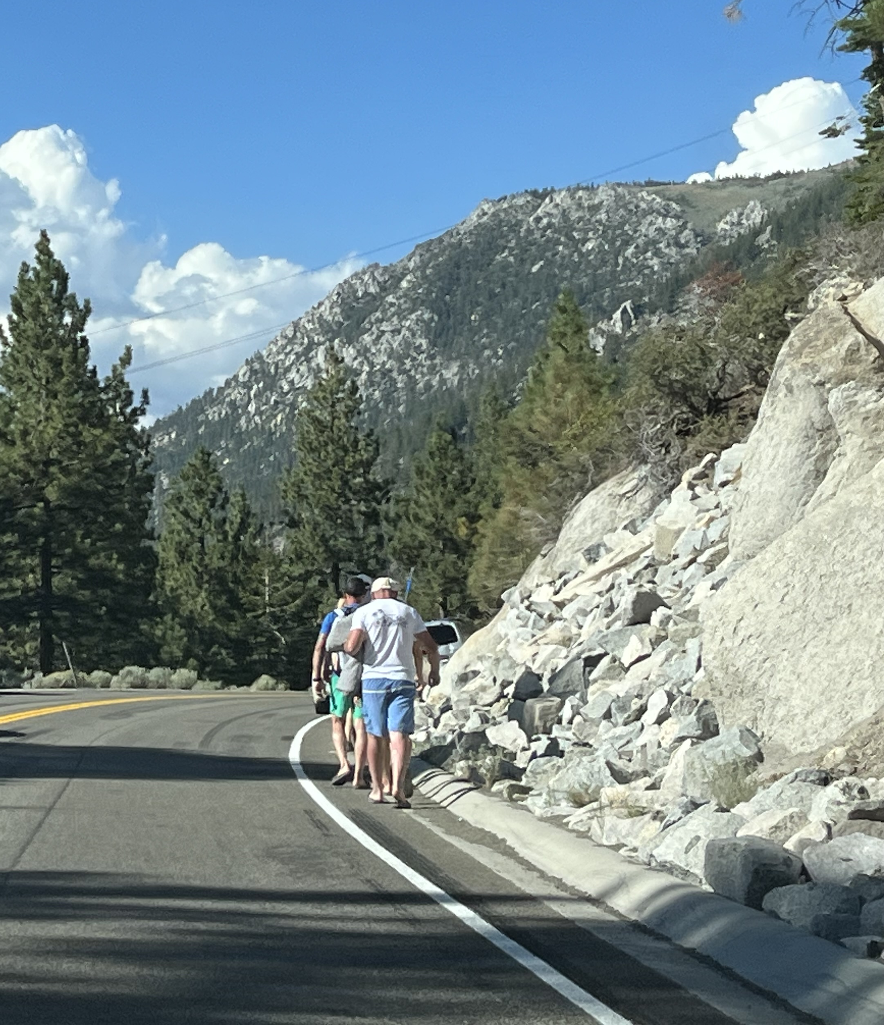

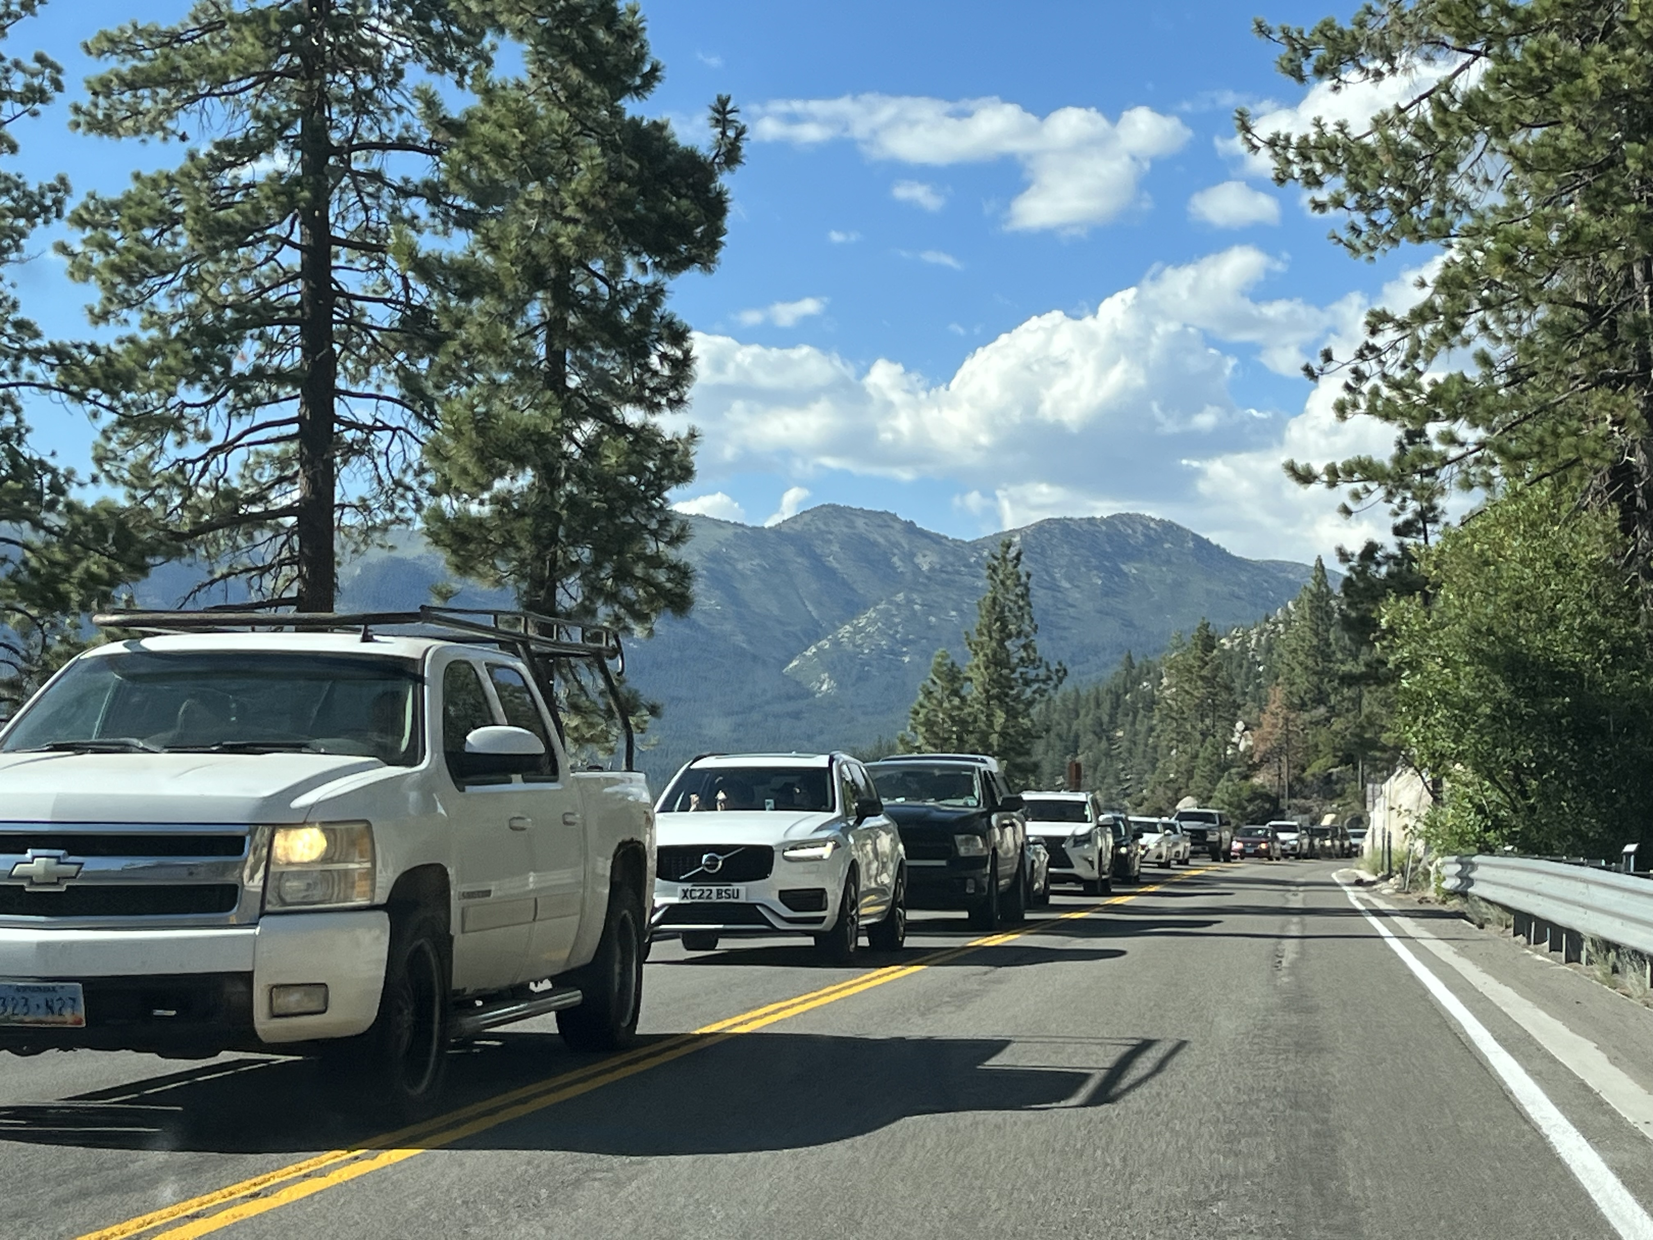

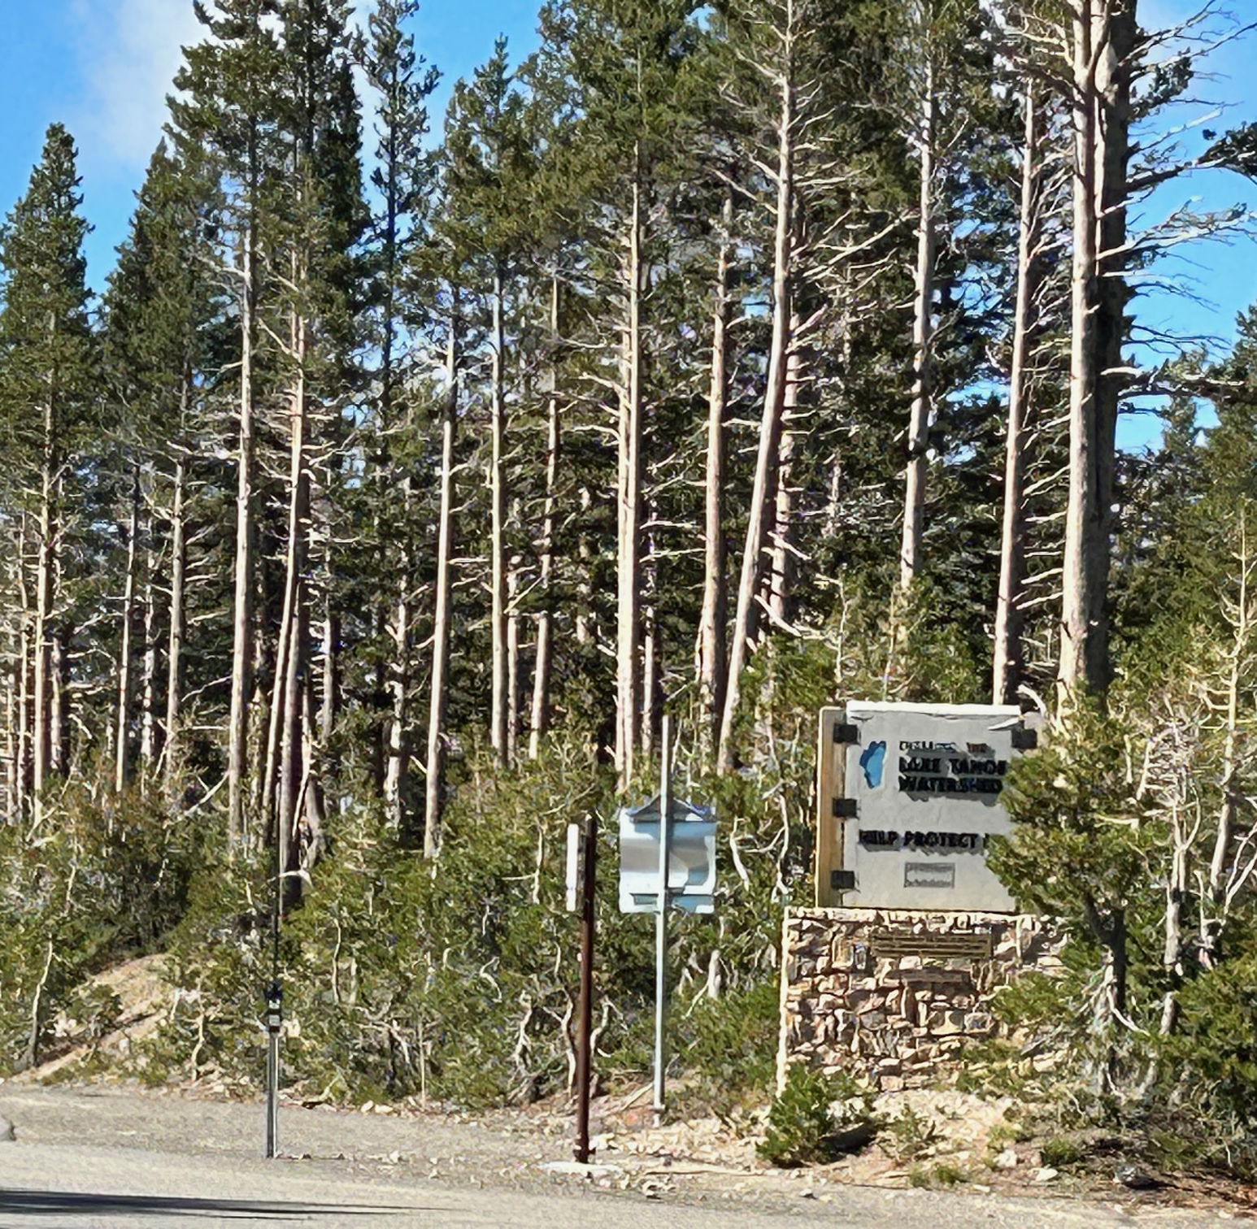
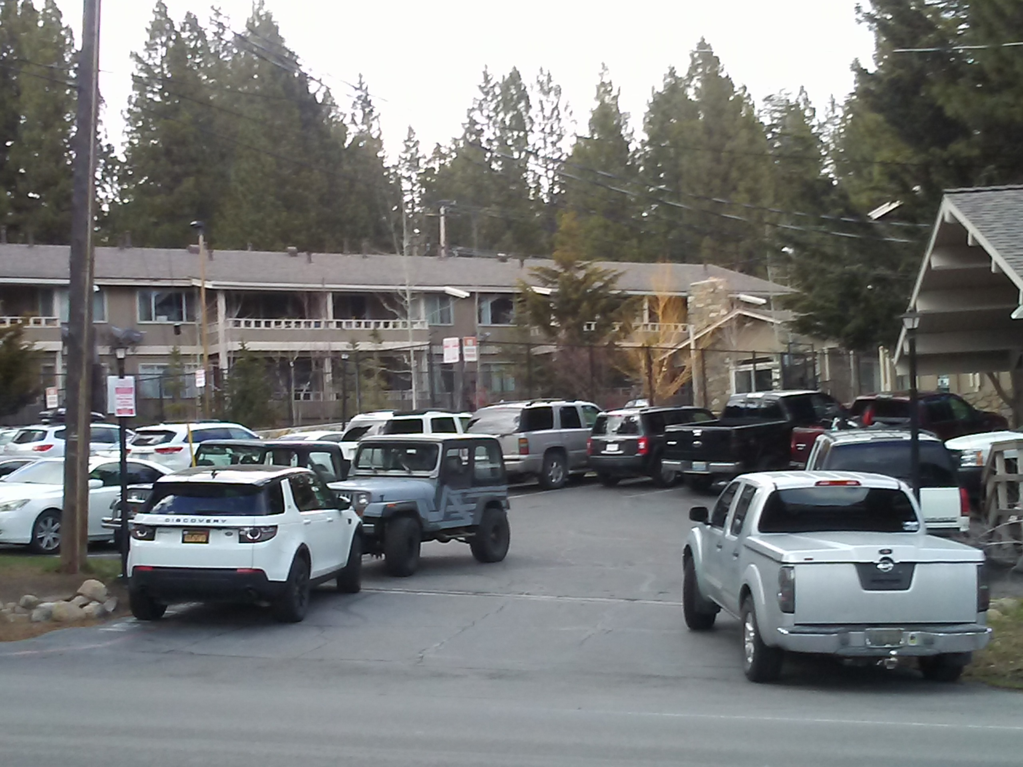
SAN FRANCISCO (KGO) -- Fodor's Travel Guide put Lake Tahoe on its list of "Ten Regions to Avoid in 2023," saying the region has become overpopulated.
Thank you for your attention.
Questions?

