Slide 1
Emergency Management & Homeland Security

Slide 2
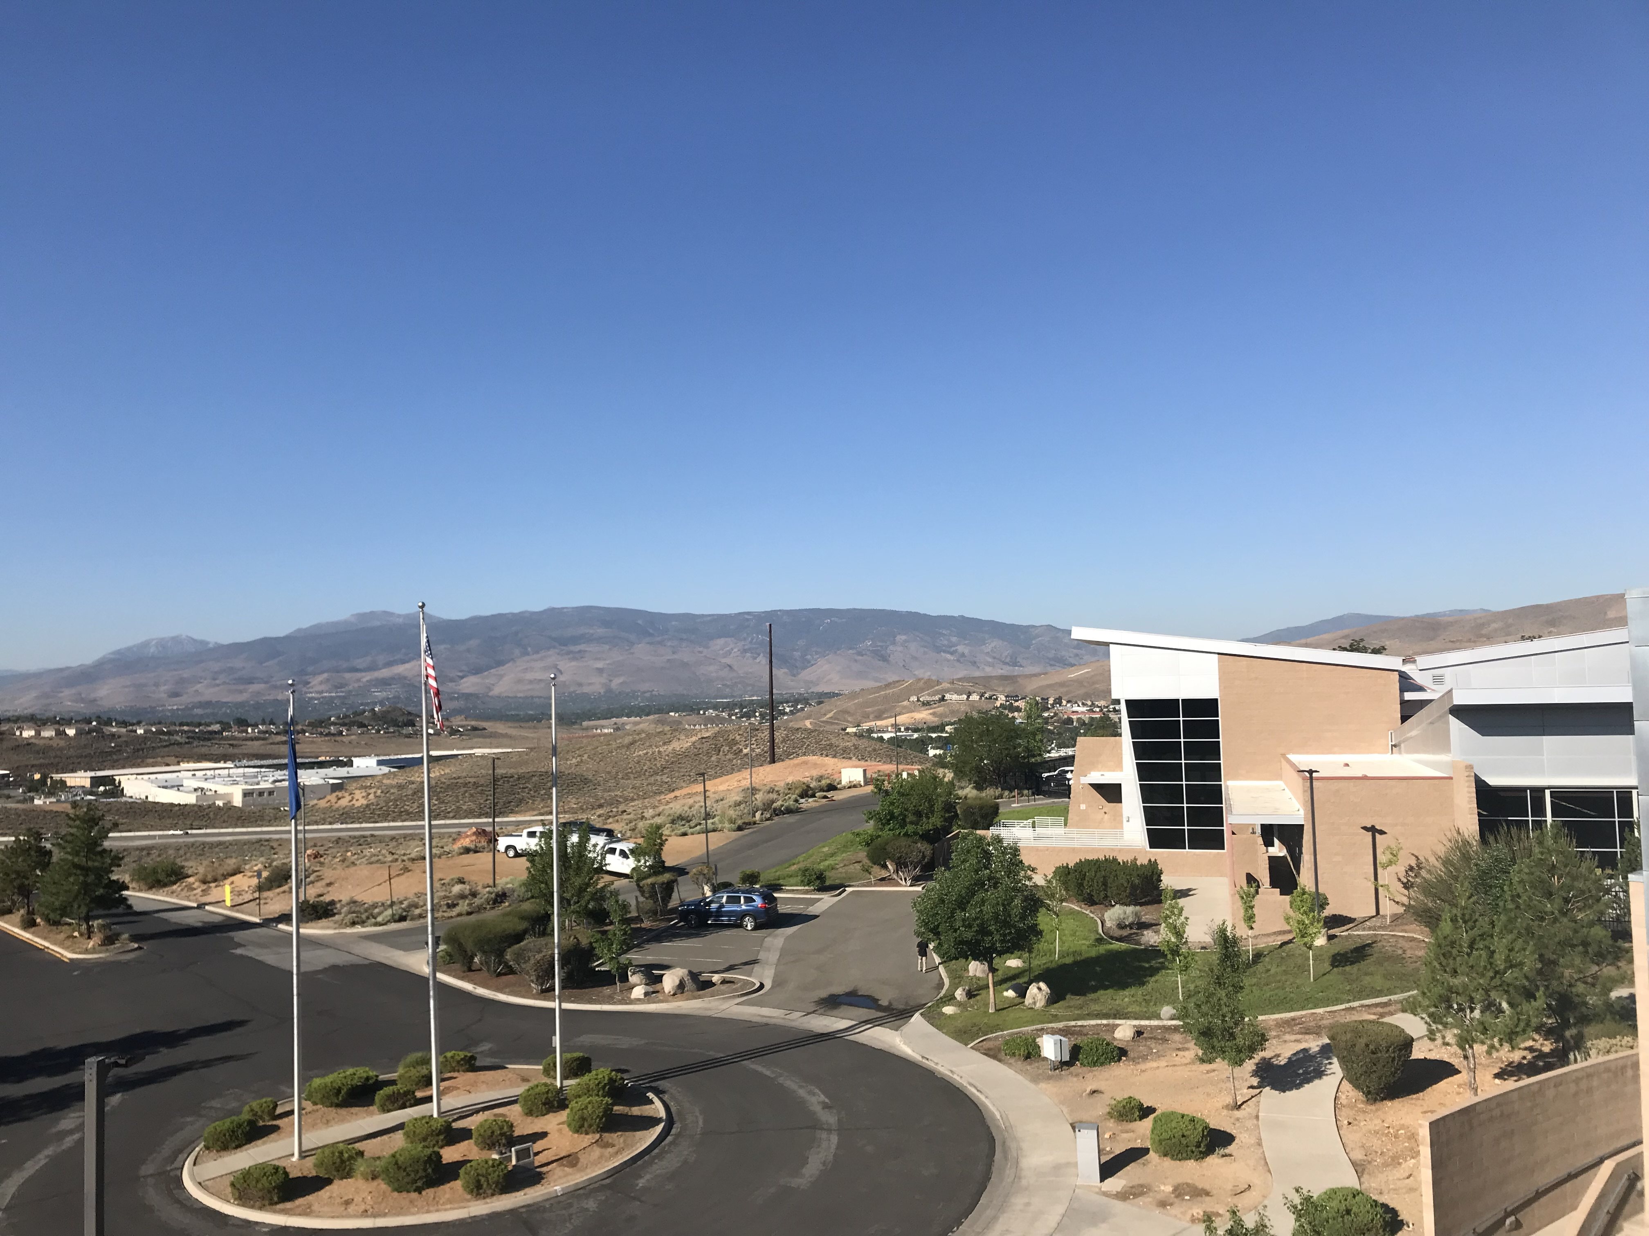
Regional Emergency Operations
Center

Slide 3
13 Hazards
Washoe County: Evacuations
Wildland Fire
Earthquake
Flood
Transportation Incident
Extreme Weather
Drought
Hazardous Materials
Infectious Disease
Avalanche/Landslide
Volcano
Criminal Acts
Radiological Waste Transport

Slide 4
Preparedness Priorities
1. Operational Coordination
2. Operational Communication
3. Mass Care Services
4. Community Resilience
5. Fatality Management Services

Slide 5
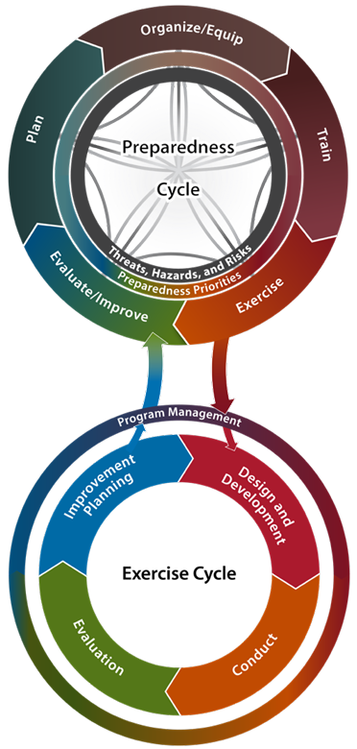
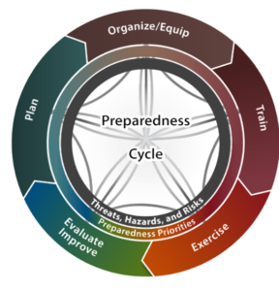
Homeland Security Exercise Evaluation Plan (HSEEP)
Washoe County: Evacuations

Slide 6
Evacuations

Slide 7
Flow of Events
Washoe County: Evacuations
Incident Occurs
Threat to the population is determined
Request for evacuation Alert sent to WCEM
WCEM Activates the Emergency Shelter Council (ESC)
Evacuation/Shelter location is determined & included in alert
Alert is sent

Slide 8
Alerts
Washoe County: Evacuations
Information includes:
Type of threat
Area being evacuated
Where to go
Evacuation point or shelter location
How to find information
Traditional and social media
www.Emergencywashoe.com
Perimetermap.com

Slide 9
Alerting Tool (CodeRED)
Washoe County: Evacuations
Allows individuals to choose the method they prefer to be notified.
WCEM staff draws a polygon larger than the evacuation area and sends the following:
EAS
WEA
Social Media
Email
Text
Voicemail

Slide 10
Challenges
Washoe County: Evacuations
Communication
Situational Awareness
Personal Awareness
Informing the community
Consistency

Slide 11
Pilot Program

Slide 12
Partners
PARTNERS

Slide 13
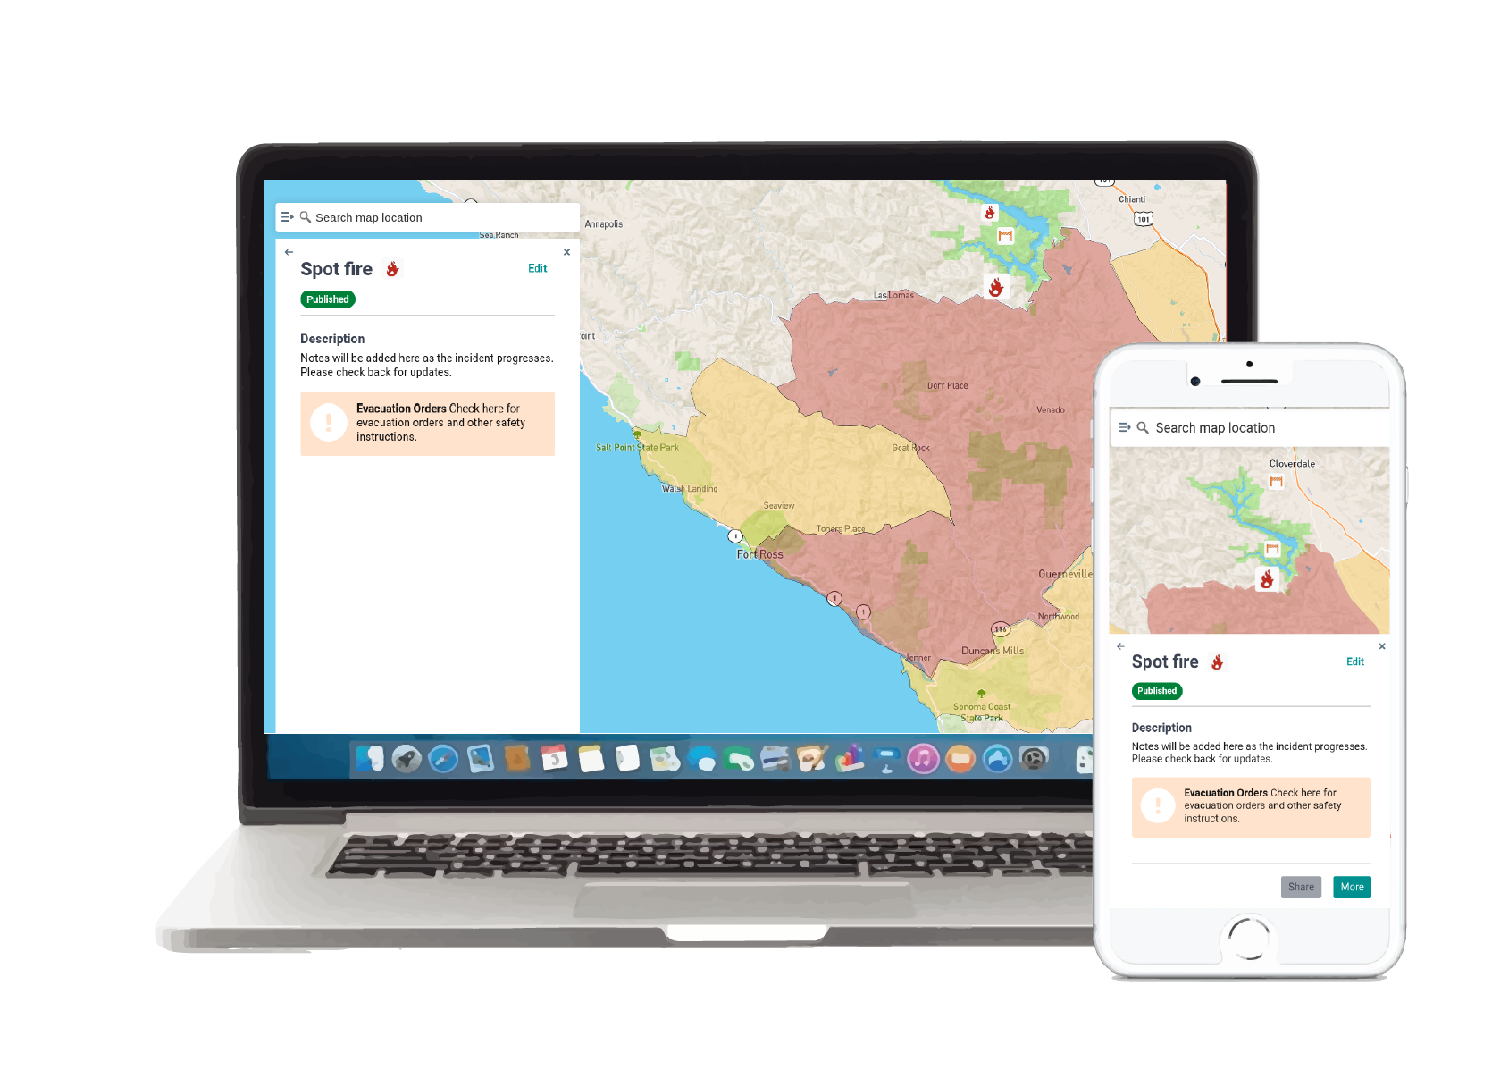
Washoe County: Evacuations
Real-time communication between fire, law, emergency management, and the public during disasters.

Slide 14
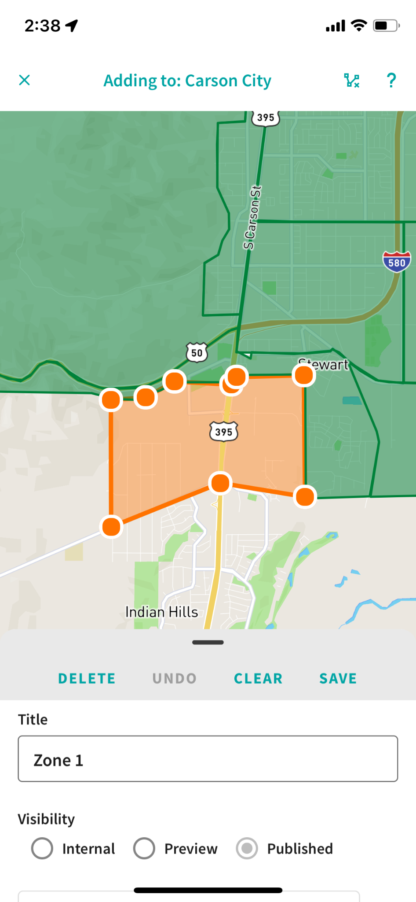
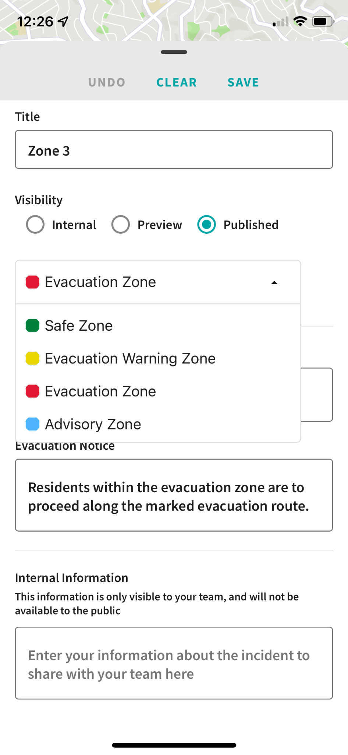
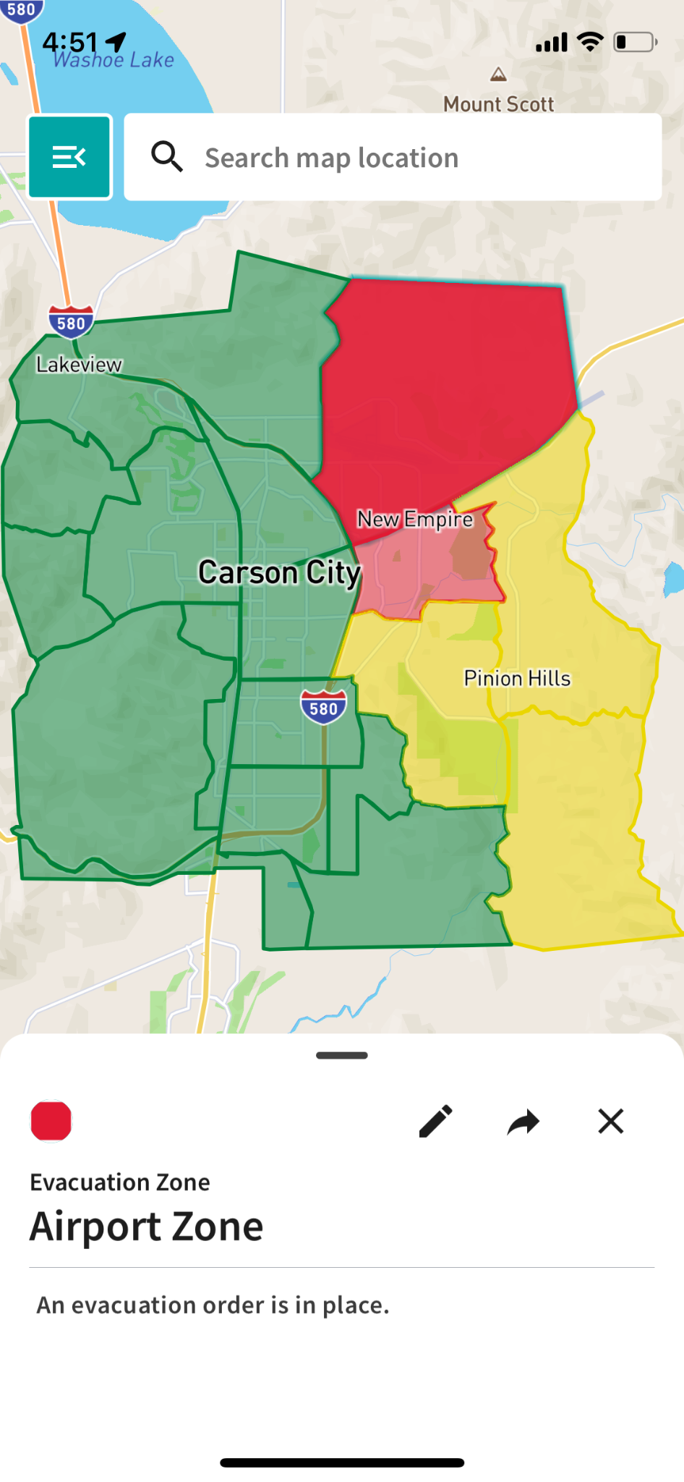
Washoe County: Evacuations
Pre-planning
Testing and training with first responders.
Real-time collaboration
Coordinate evacuations with other agencies in real-time.
Alert the public
Publish evacuation areas and instructions to the public.

Slide 15
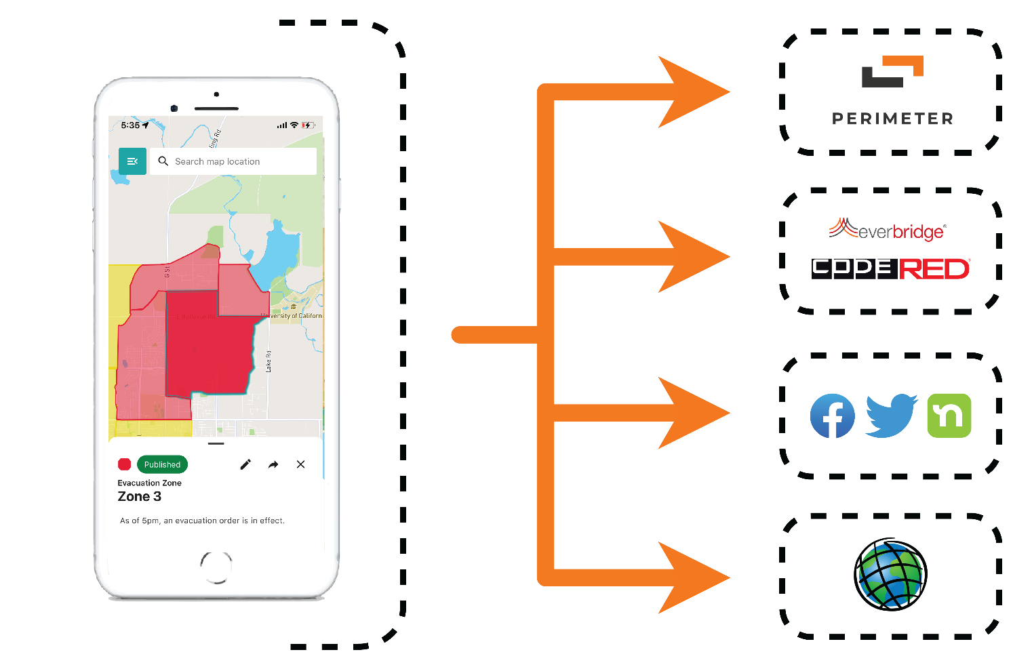
Cross-channel communication
Washoe County: Evacuations
Public web app
Notification systems
Social media
GIS tools

Slide 16
Perimeter Platform is designed for:
Washoe County: Evacuations
Real-time data updates.
Low-connectivity environments.
Accessibility and ease-of-use.
Integration with existing department tools and notification channels.
Cross-agency collaboration across jurisdictions.

Slide 17
What You Can Do:
Washoe County: Evacuations
Have a Kit
Make a Plan
Meeting place inside your neighborhood & outside
Local POC & Long-distance
Methods for communication
Place for pets
Stay Informed
Check verified social media accounts
Traditional News Media
www.Emergencywashoe.com

Slide 18
Evacuation Video

Slide 19
Video
Decision making
Steps for alerting
What people will see/experience
Information to aid with individual decision making
Setting expectations

Slide 20
Full Scale Exercise

Slide 21
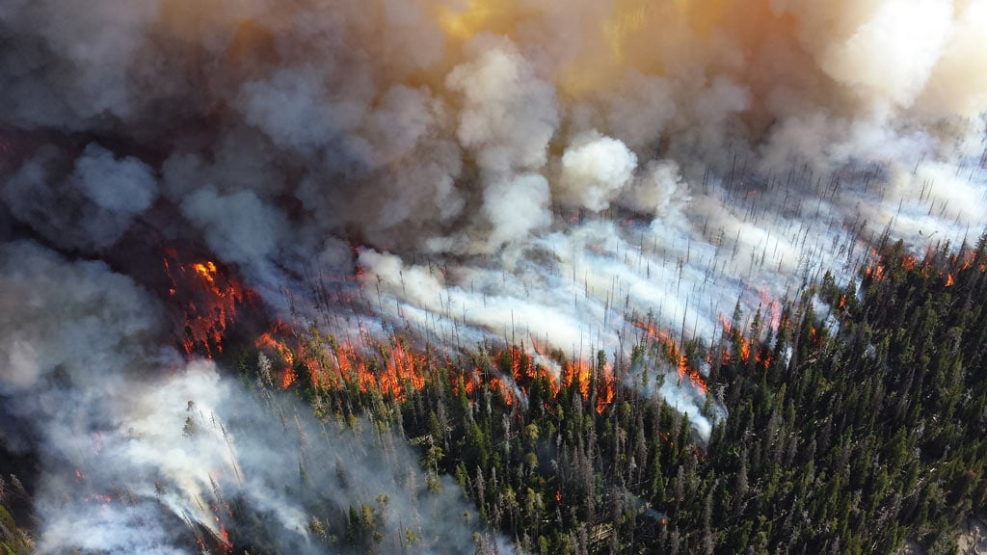
Incline Village Full-Scale Exercise
August 16th
9a – 130p
Wildfire scenario
Alerts & Media
2nd Creek Evacuations
Responders
Preparedness Fair

Slide 22
Planning

Slide 23
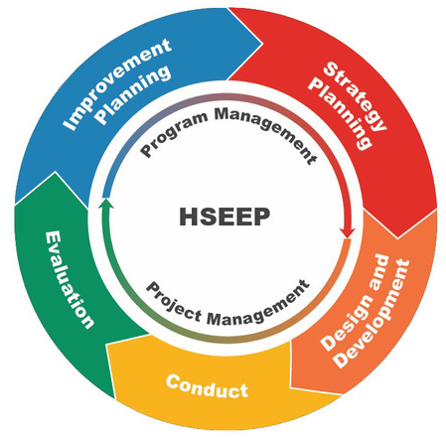
Evacuation, Sheltering, & Mass Care Plan
3 parts to this plan
5 phases to our update
HSEEP
Exercise GAP identification
Plan update

Slide 24
Thank You!

